Slide 1
AzAHP ACC/RBHA Workforce Development Alliance
September 2023 Provider Forum

Slide 2
Our Mission
To evaluate, monitor, and support the development of the Capability, Capacity, Connectivity, Culture, and Commitment of our provider workforce leading to a competent workforce that is capable of producing optimal member outcomes.
McDowell Mountain Preserve

Slide 3
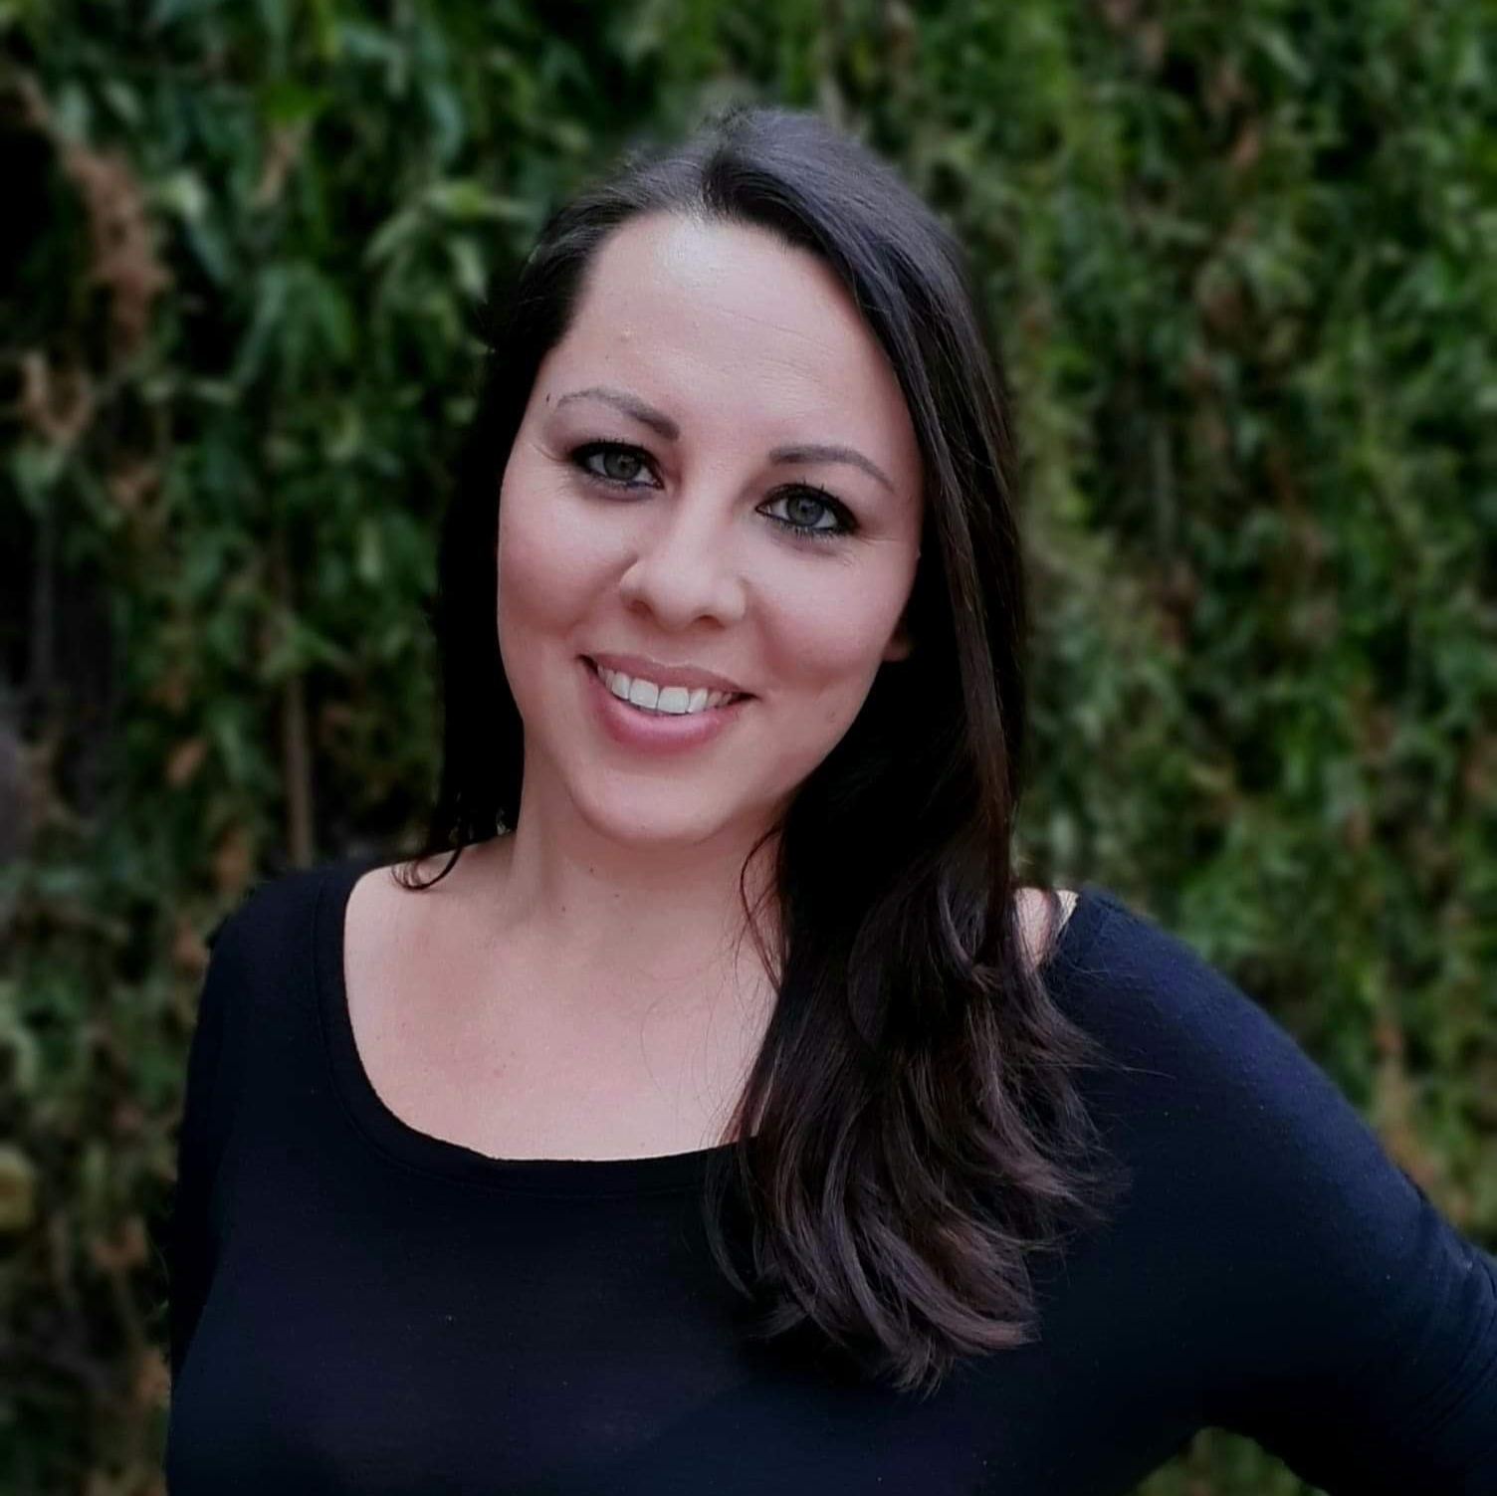
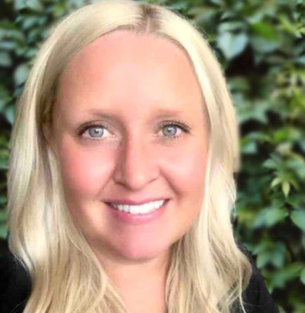
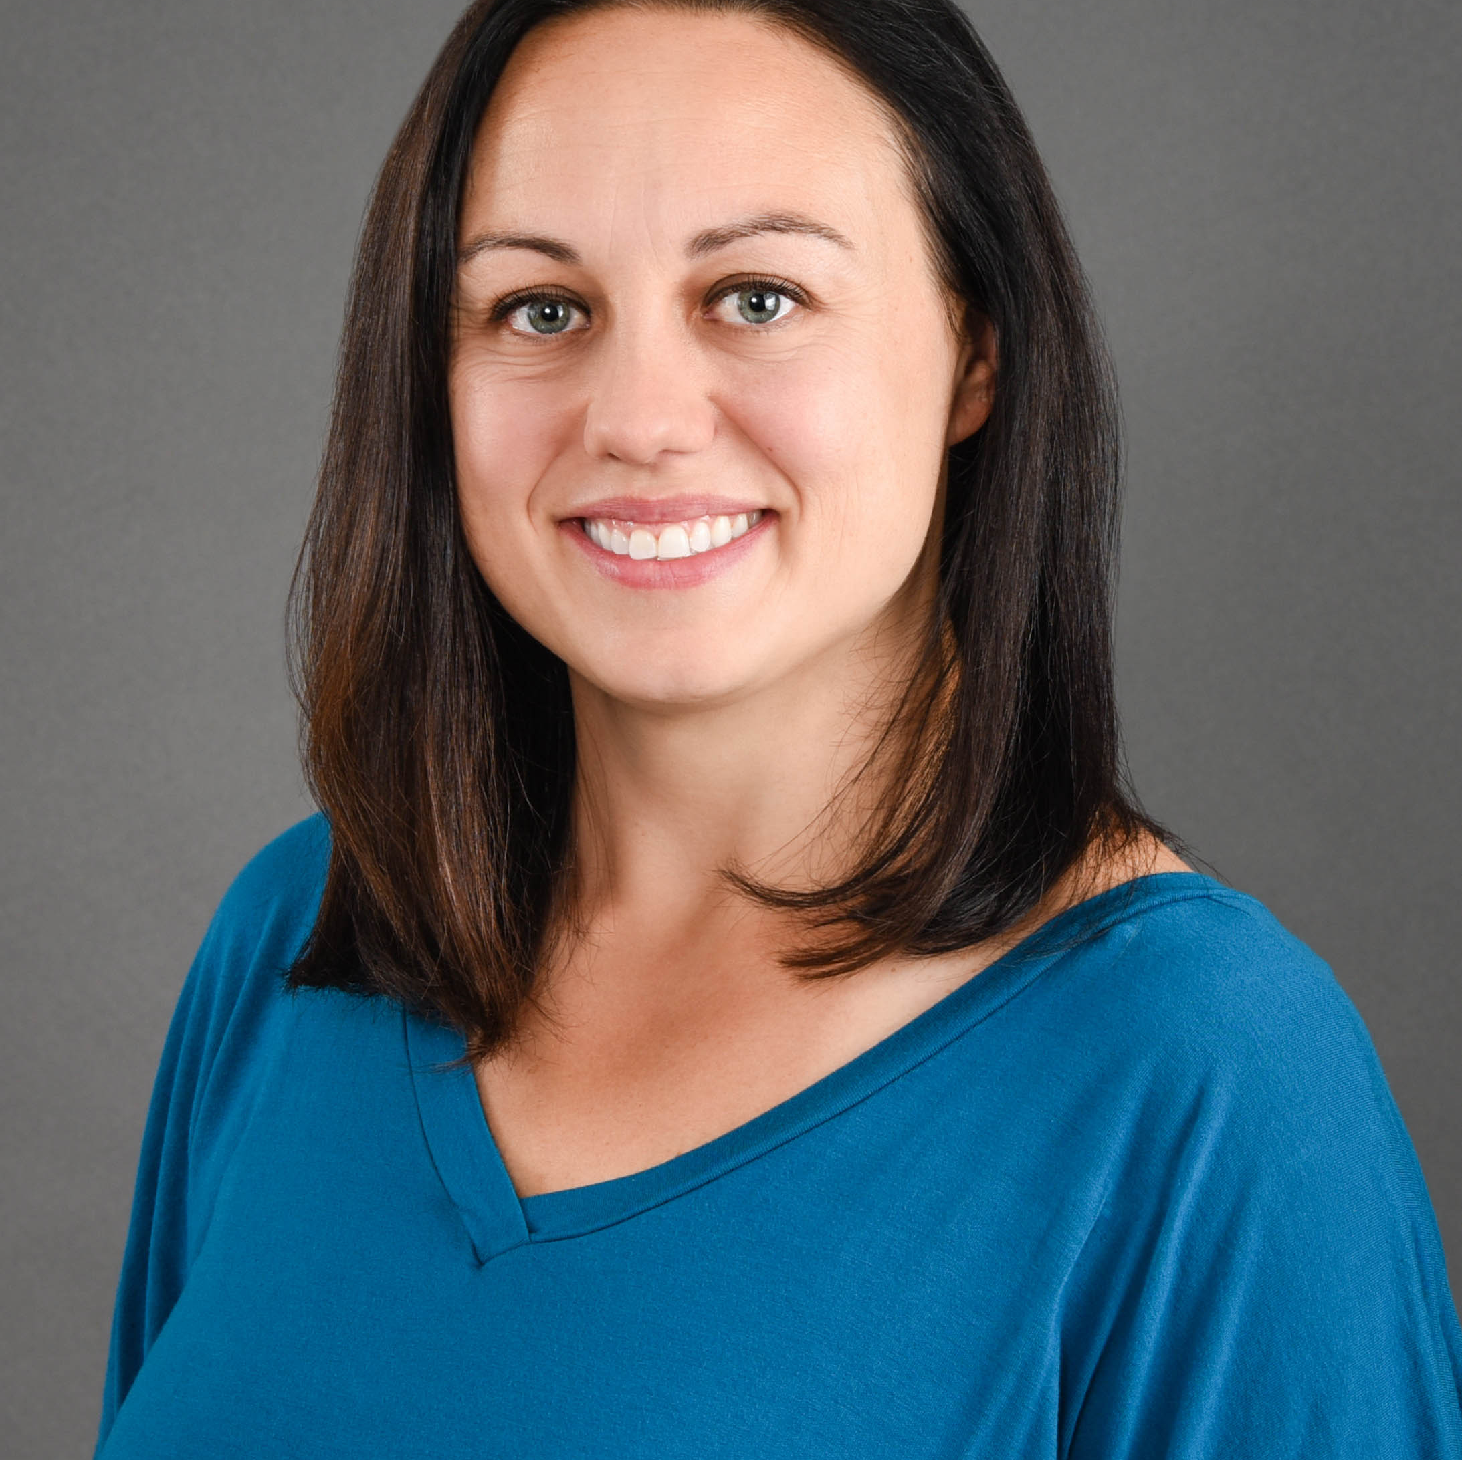
AzAHP Workforce Development Alliance
Yvette Tucker
Arizona Complete Health
Workforce Development Administrator
ACC & RBHA
Selena McDonald
Banner - University Health Plans
Workforce Development Administrator
ACC
Mark Faul
Care1st Health Plan Arizona
Workforce Development Administrator
ACC & RBHA
Jennifer Elkins
Health Choice Arizona
Workforce Development Administrator
ACC
Sarah Hauck
Mercy Care
Workforce Development Administrator
ACC, ALTCS, DD, DCS/CHP, RBHA
Britt Spano
Molina Health Care
Workforce Development Administrator
ACC
Layla Bishop
UnitedHealthcare Community Plan
Workforce Development Administrator
ACC, ALTCS & DD
Laura Raymond
Arizona Association of Health Plans
Consultant / Workforce Development Program Manager

Slide 4
Relias Update – Joe Chemali
Reminders & Resources (RnR) – Layla Bishop
Heritage, History & Health Observances - Jennifer Elkins
Training Opportunities - Yvette Tucker
Quarterly Reporting – Mark Faul
P-WFDP Template – Sarah Hauck
CFT Update & Survey - Layla Bishop/ Mike Tripp
Best Practices in Workforce Development - Yvette Tucker
Brain Bites – Self Care Reminder: Selena McDonald
AGENDA

Slide 5
Heritage, History & Health Observances
Patriot Day & National Day of Service and Remembrance
Hispanic Heritage Month
National Hispanic American Heritage Month 2022 (hispanicheritagemonth.gov)
Suicide Prevention Month
Suicide Prevention Month | NAMI: National Alliance on Mental Illness
Childhood Cancer Awareness Month
Self-Care Awareness Month

Slide 6
Heritage, History & Health Observances - October
Disability Employment Awareness Month
Breast Cancer Awareness Month
World Mental Health Day (Oct 10)
Indigenous Peoples Day
Health Literacy Month

Slide 7
Fun Celebrations
Play-Doh Day – Sep 16
Cheeseburger Day – Sep 18
Queso Day – Sep 20
Coffee Day – Sep 29

Slide 8
Relias Updates
Register for our Upcoming Relias Training Webinars
Relias Custom Modules Workshop hosted by Joe on September 27 @ 11AM-12PM AZ Time
https://relias.webex.com/relias/j.php?MTID=ma45d0ac1ec75645ee11052fbc18858af
Relias Competency Evaluation Workshop hosted by Joe on October 25 @ 11:30PM-12:30PM AZ Time
https://relias.webex.com/relias/j.php?MTID=m9c9daa3afe6dd9a6398063213e881e94
Relias to Host Competency Evaluation Feedback Sessions
Relias has heard your voices and we want to setup two feedback/interview type sessions for AzAHP Providers that work the Competency Evaluation tool so we can gather valuable feedback. We want to understand what your workflows and pain points are when working with the new tool so that we can discuss together with our Relias User Experience and Product Management Team members so that we can work towards making more improvements with the new tool!
Relias Competency Evaluation Feedback/Interview Session 1 on 10/2 @ 4PM EST.
https://relias.webex.com/relias/j.php?MTID=m89eb74da7040f2892f6497d2bd17ed45
Relias Competency Evaluation Feedback/Interview Session 2 on 10/9 @ 2PM EST.
https://relias.webex.com/relias/j.php?MTID=mb3a2fafcc59304e1a7430bfc5751252c

Slide 9
Relias Updates
Relias Reporting Workshop Recording
If you missed our Relias Reporting Workshop that I hosted on 8/24, fear not as that meeting was recorded! Please visit the AzAHP Relias page at https://azahp.org/azahp/azahp-accrhba-awfda/relias/ to access the Webinar Archives including the Relias Reporting Workshop webinar!
Relias Impact Nation
Our 10th annual Impact Nation Conference is a free, virtual, all-day customer conference focused on empowering you, your organization, and the communities you serve. Across three tracks and 18 sessions, you’ll receive unparalleled access to client stories, product releases, and feature updates. From sharing customer stories to Relias Platform tips and tricks, this conference is designed to bring you the resources you need to stay informed and make the most impact at your organization.
Link for more information/agenda/registration: https://na.eventscloud.com/website/56703/
SMS Training Alert Text Message Reminders Setting Enabled
Site Setting can be disabled from your site "Settings" tab under the "Miscellaneous Site Settings". If this setting is disabled, learners will not be able to opt-in for these alerts. Learners MUST opt-in to start receiving text message alerts. Learners can choose to opt-in by visiting their "Account Profile" page and by following the instructions under the "Notification Information" section in the learner profile.
Virtual Classroom Demo
Now that you have access to the Virtual Classroom Live Event sessions, let's look at this new functionality!

Slide 10
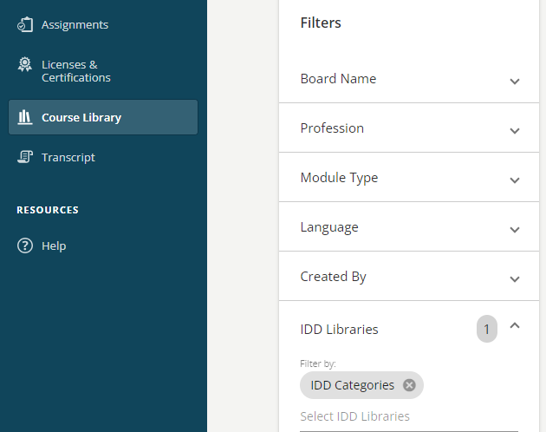
Relias Tips/Tricks
Custom Filter for IDD Libraries Available
With the new IDD libraries available, we wanted to provide an easy way to find those courses quickly that are associated with all the IDD categories that were added. You can now utilize the "IDD Categories" option which is located under the "IDD Libraries" filter option when searching for courses in your Module List or Course Library!
Did you know?
You may have noticed that when searching for unique course titles and course codes in the Course Library as a learner may not return exact results. Try placing quotation marks around the course title or course code that you input in the search bar so you will get exact matches in the returned results!

Slide 11
Relias Administrative Mastery Program (RAMP)
RAMP is a training plan program for Relias Administrators that covers site and overview, user management, hierarchy, courses, training plans, and reporting in the Relias Platform that is available in your training plan list for Relias Administrators to self-enroll into!
Navigate to your Training Plan List from your Relias Administrator profile and search for "RAMP" if you would like to self-enroll.
The courses will take between 30-90 minutes and include knowledge checks throughout to aid with knowledge retention.
Become certified as a Relias Administrator upon completion!

Slide 12
Relias Office Hours
Have questions or new to your role? Relias CSM, Relias Connect, & Relias Support by your side!
Enterprise Client Success Manager
Joe Chemali
jchemali@relias.com
Relias Technical Support
1-800-381-2321
Hours of Operation: Mon – Fri (8 AM - 8 PM EST)
Relias Connect
AzAHP Learner Support
1-833-224-4008
Hours of Operation: Mon – Fri (8 AM - 8 PM EST)
Link to Resource: https://connect.relias.com/s/learner-page/aA13w000000k9xdCAA/paid-learner-support-page-for-arizona-association-of-health-plans-inc

Slide 13
CFT Supervision Tool Requirements
How is this requirement met?
This requirement is met by the completion of the 90-day, 6 Month, and Annual Competency Evaluation Tool in Relias for each CFT Facilitator
Healthplan Monitoring- Quarterly Reports on the completion of the Competency Evaluation Tool in Relias for each Agency who facilitates CFT’s
AMPM 200 and 220

Slide 14
Update to the CFT Supervision Tool
The original “Skills” will be removed, only the Skills/Competencies will remain
All current employees enrolled in the Competency Evaluation Tool will be transferred over to the new version by Relias

Slide 15
2-Day Child and Family Team Training Survey
Announcement is intended for Providers serving children and adolescents in our Children’s System of Care (CSOC) and have employees who facilitate CFT’s. If you are not such a Provider, you may disregard this message.
Together, we partnered to deliver:
17 CFT Facilitator TtT Sessions with 194 attendees
14 CFT Supervisor TtT Sessions with 164 attendees
2 of 3 Triannual CFT Champion meetings
2 Relias Administrator training webinar
Feedback is an important tool that enables discovery, which fosters opportunity for collaboration and innovation. Having reached the 1-year mark, a survey has been prepared by Health Plans and AHCCCS to capture the voice of our CFT Champions and the Provider organizations who support this effort. This communication will also go out to the CFT Champions.
Survey launch: Monday September 18, 2023 Survey close: Monday October 2, 2023
Our Ask: Upon receipt, please adhere to the following directions for survey submission:
Only respond to the survey if your organization has facilitated at least one 2-Day CFT Facilitator Training
Submit only one survey per agency
Please coordinate the completion and submission of your agency’s feedback by identifying one respondent to collaborate with internal team members (CFT Champions, Training Leadership, Relias Administrators etc.)

Slide 16
Quarterly Reporting
Health Plan Fraud (0.75hrs) Due: October 31st
Q2 report will be run on 10/31 at 8am (include courses due from 7/1-9/30/23).
Click Here: Reporting Job Aids

Slide 17
Provider – Workforce Development Plan (P-WFDP)
10/12/23: Template Release Date
Nov-Feb: P-WFDP Monthly Workshops (Dates TBD in Oct)
Provider Forum Presentations:
10/12: SMART Goals (Focus Employment Services
11/09: Coaching/Mentoring (TBD)
No Provider Forum in December
01/11: SMART Goals (Arizona Center for Change
02/08: Staff Development & Recognition (Horizon Health & Wellness)
02/1/2024 – 02/28/2024: P-WFDP Due between these dates
PURPOSE:
The purpose of the P-WFDP is to encourage Provider organizations to work together and ensure members receive services from a workforce that is qualified, competent, and sufficiently staffed. The P-WFDP shall include a description of organizational goals, objectives, tasks, and timelines to develop the workforce. The overall approach and philosophy to Workforce Development is to ensure a comprehensive, systematic, and measurable structure that incorporates best practices at all levels of service delivery and utilizes Adult/Children’s Guiding Principles, Adult Learning Theories/Methods, Trauma-informed Care, Equitable Services and Culturally Competent practices. All training initiatives, action steps, and monitoring procedures outlined in the P-WFDP are to include targeted efforts for all employees (e.g., direct care Providers, supervisors, administrators, and support staff) who are paid by, partially paid by, or
support an agency’s Health Plan contract(s).

Slide 18
Training Opportunities
Registration is now open-
Individual or group registration available,
In person event or virtual,
Virtual scholarships offered
Learn More:
https://azhealthequity.org/

Slide 19
Training Opportunities
Registration is now open
In person event,
CEUs available, no charge
Learn More:
https://allevents.in/phoenix/19th-annual-cesar-chavez-conference/200025267696837

Slide 20
Training Opportunities
Registration is now open-
In person event,
early bird pricing,
scholarships available,
CEUs offered
https://letsgetbettertogetheraz.org/

Slide 21
Training Opportunities
Social Justice Leadership Academy Learning Series-
Register for all the remaining 2023 sessions! Make sure you don’t miss a minute of the latest information, tools and updates you need to address health inequities.
The SJLA Learning Series is a free virtual series with monthly learning events that provide members of the health care workforce with tools to lead and sustain efforts to eliminate health inequities. Topics include structural and systemic inequities in mental wellbeing, structural and systemic biases, criminal justice reform, applying change management principles to advance social justice within organizations and more. Learning events are a combination of informational presentations, workshops and guided discussions.

Slide 22
Training Opportunities
Maricopa Community Colleges in partnership with AHCCCS has scholarship money for certificate programs and an associate's degree in areas such as: Behavioral Health Sciences and Developmental Disabilities.
Introducing the Arizona Health Care Cost Containment System (AHCCCS) Scholarships— a transformative, new award program at Maricopa Community Colleges for students pursuing careers in direct care and behavioral health. With funds provided by the American Rescue Plan Act, AHCCCS has partnered with Maricopa Community Colleges to increase and enhance career development, education, and training opportunities for the Home and Community-Based Services (HCBS) workforce.
Learn more about Maricopa Community Colleges Behavioral Science and Human Services Field of Interest.
The AHCCCS Scholarships offer a competitive student award covering the cost of:
Tuition
Books
Course fees
Other needed resources
Learn more: https://www.maricopa.edu/students/financial-aid-resources/scholarships/ahcccs-scholarships
Questions about the scholarships may be directed to:
AHCCCS-Scholarships@domail.maricopa.edu

Slide 23
Best Practices in Workforce Development
The Arizona Health Care Cost Containment System (AHCCCS)— Best Practices in Workforce Development Professional Development initiative is funded by the American Rescue Plan Act and is a unique opportunity that will focus on professional development and competency-building for behavioral health workforce development and training staff.
As the nature of work continues to change at an unprecedented pace, professionals in workforce/talent development and training roles, must too, adapt and continuously improve themselves to unlock their full potential to drive impact.

Slide 24
Best Practices in WFD

Slide 25
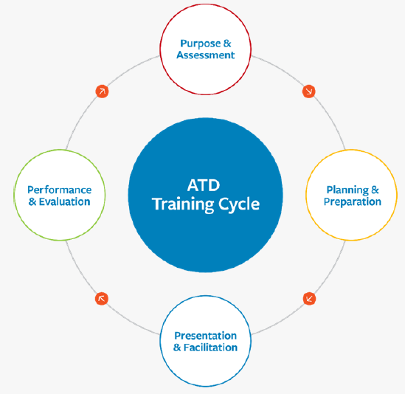
Best Practices in WFD- Professional Development

Slide 26
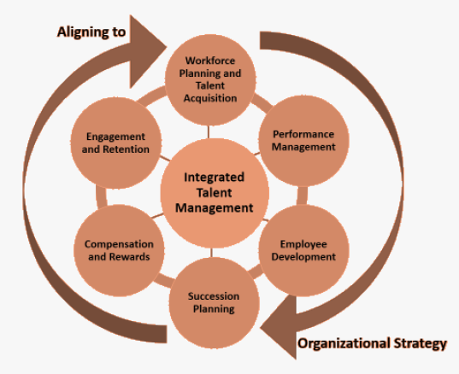
Best Practices in WFD- Professional Development

Slide 27
BRAIN BITES
Self - Care

Slide 28
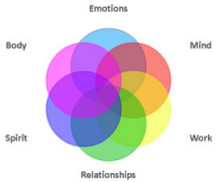
Brain Bites – Self Care
Self-care refers to activities and practices that we can engage in on a regular basis to reduce stress and maintain and enhance our short- and longer-term health and well-being. Self-care is necessary for your effectiveness and success in honoring your professional and personal commitments.

Slide 29
Brain Bites – Self Care
Taking care of physical and psychological health
Managing and reducing stress
Honoring emotional and spiritual needs
Fostering and sustaining relationships
Achieving an equilibrium across one's personal, school, and work lives
Notes:
Self-care is not simply about limiting or addressing professional stressors. It is also about enhancing your overall well-being. There are common aims to almost all self-care efforts.
Each of us may differ in the domains we emphasize and the balance we seek among them.

Slide 30
Brain Bites – Self Care
10 Simple Self Care Strategies in 10 Minutes or Less
Take a walk around the block: You probably need to get out of your office / house. In fact, you definitely do.
Call a friend: Plan something fun or just catch up. Choose a friend who doesn’t drain you.
Watch something funny: A sitcom – Comedian – Bloopers - Give yourself permission to laugh.
Brain dump/Journal: Hoarding stressful thoughts is masochistic. Create some white space in your brain by setting a timer for 5 minutes and just get it all out on paper. If you must, you can come back to it later.
Try 5-10 minutes of coherent breathing: Play calming music, close your eyes and allow your breath to sync with the rhythm. It’s extremely relaxing and meditative.

Slide 31
Brain Bites – Self Care
10 Simple Self Care Strategies in 10 Minutes or Less
Do a guided meditation: Try a body scan to bring some relaxation to your whole body from head to toe. Insight Meditation Timer app, which has a ton of great guided meditation options.
Eat a healthy snack: Maslow’s hierarchy of needs! Go back to the basics. Try eating slowly and with no distractions.
Turn on some music and dance like no one’s watching: Salsa, interpretive dance, doesn’t matter! This can often seem counterintuitive when all you want to do is take a snooze, but movement fires off endorphins is a natural mood booster and an excellent form of self-care.
Practice mindfulness: Try some simple breathing, while bringing focus to the tip of your nose where the air enters and exits. Stay with your breathing. As you notice thoughts entering your awareness, just allow them to roll on, like clouds passing by. Gently bring your attention back to the breath.
Write your session note: Yes, getting work done can be a form of self-care. Crossing off something from the “to-do” list can be a huge relief. And using structured notes templates is a quick and easy way to do it.

Slide 32
R & R Reminders and Resources
Relias Training of the Month
None ☺
October Training
.*AHCCCS – Health Plan Fraud (0.75hrs) Due: October 31st

Slide 33
Laura –
We will miss you so much! Thank you for all you have done for our Arizona WFD Alliance and the Network of Providers we serve. We wish you the best of LUCK on your new adventure!

Slide 34
Open Discussion: Questions, Suggestions, Ideas & Feedback

Slide 35
Closing/Next Meeting
Next meeting: October 12, 2023 11:00 AM – 12:30 PM

Slide 36
Thank You!

