Slide 1
Arizona Workforce Development Alliance (ACC, ACC-RBHA)
January 2024 Provider Forum

Slide 2
AGENDA
Reminders & Resources (RnR) – Yvette T.
Best Practices in WFD – Yvette T.
Quarterly Reporting – Selena M.
Year in Review – Selena M.
Relias Update – Sylvia S.
Brain Bites – AZ Center for Change – Jodi S.
Heritage, History & Health Observances – Yvette T.
P-WFDP Reminder & Workshops – Selena M.
Legacy Spotlight – Sarah H.
AHWGMA – Layla B.
Child and Family Team/ Competency Evaluation Tool Updates – Layla B.
Pipeline – Kate L.

Slide 3
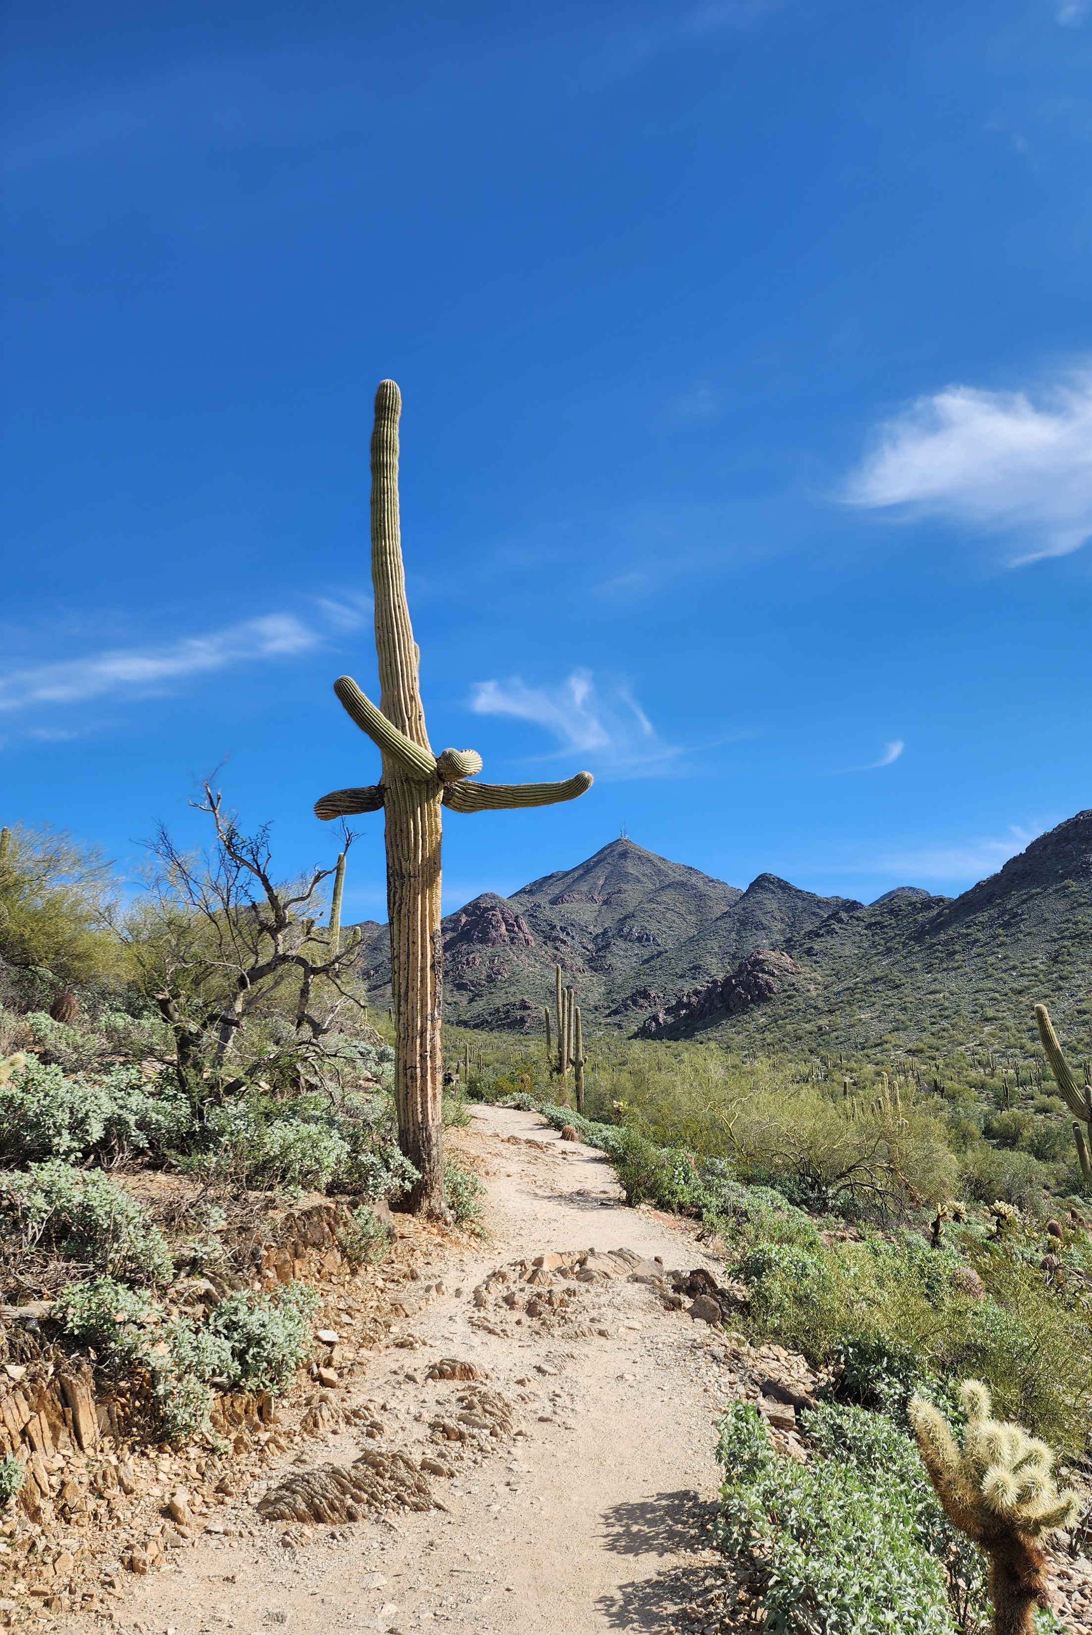
Our Mission
To evaluate, monitor, and support the development of the Capability, Capacity, Connectivity, Culture, and Commitment of our provider workforce leading to a competent workforce that is capable of producing optimal member outcomes.
McDowell Mountain Preserve

Slide 4
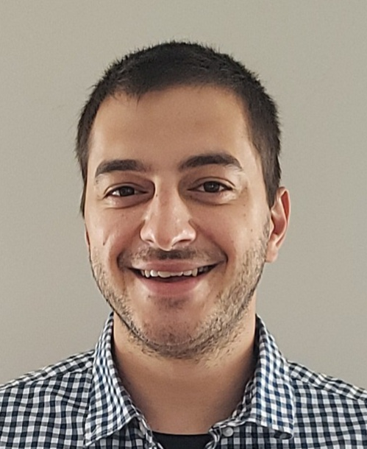
Arizona Workforce Development Alliance Members
Yvette Tucker
Arizona Complete Health
Workforce Development Administrator
ACC-RBHA
Selena McDonald
Banner - University Health Plans
Workforce Development Administrator
ACC
Cori McLain
Banner - University Health Plans
Workforce Development
ACC
Mark Faul
Care1st Health Plan Arizona
Workforce Development Administrator
ACC-RBHA
Jennifer Elkins
Health Choice Arizona
Workforce Development Administrator
ACC
Sarah Hauck
Mercy Care
Workforce Development Administrator
ACC-RBHA, ALTCS, DD, DCS/CHP
Mike Tripp
Mercy Care
Workforce Development Manager
ACC-RBHA, ALTCS, DD, DCS/CHP
Veronica De La O
Molina Health Care
Workforce Development Administrator
ACC
Layla Bishop
UnitedHealthcare
Community Plan
Workforce Development Administrator
ACC, ALTCS & DD
Sylvia Sanders
Arizona Association of
Health Plans
Consultant / Workforce Development Program Manager
Joe Chemali
Relias
Enterprise
Client Success
Manager
Notes:
Our WFD team is growing and we have added a few new members to our team this year, because we have so many big projects and initiatives we are working on.

Slide 6
2023 Accomplishments & 2024 Goals
American Rescue Plan (ARP) Projects
Provider Workforce Database
Arizona Healthcare Careers Hub (FKA Career Pathways)
Career Education and Training (CET) – trainings should be made available to providers in late 2024 or early 2025
AMPM 570- Case Management (CM)
DCW and DSP
Leadership/Supervision
More…
Evaluation of WFD Initiatives and best practices
Future Goals
Implementation of ARP projects by September 2024

Slide 7
2023 Accomplishments & 2024 Goals
Non-ARP Course Development Updates and Initiatives
Child and Family Team
Culture Care and You FKA CC100
Future Goals
More to come on Child Family Team (CFT)
Revamp CFT Overview Prework)
Implement the Relias Competency Evaluation Tool for AHCCCS CFT Supervision Tool
Stakeholder training
Social Determinants of Health (SDOH)
Continue conversations with AHCCCS regarding Social Determinants of Health initiatives to determine the best approach in supporting and educating our statewide provider network.

Slide 8
2023 Accomplishments & 2024 Goals
Data Collection Efforts
Completed analysis of:
2022 iteration of the Arizona Healthcare Workforce Goals and Metrics Assessment (AHWGMA)
2023 iteration of the Healthcare Network Employee Questionnaire (HNEQ)
2023 iteration of the Provider Workforce Development Plan (P-WFDP)
Future Goals
The Coalition will enhance the data collected through each method for 2024 iterations
Complete workshops, reviews and analysis for 2024 P-WFDP submissions
Complete workshops, collection and analysis of AHWGMA
Database to eventually replace the AHWGMA
Complete workshops, collection and analysis of HNEQ
Revise the HNEQ to gather the most pertinent information to support effective change
Identify an effective method to capture data that represents all LOBs
Create and implement effective recommendations to support Providers

Slide 9
2023 Accomplishments & 2024 Goals
AZ Workforce Development Advisory Committee – ACC, ACC-RBHA
Confirmed participation of 15 provider agencies
Identified advisory committee charter and guidelines
Active participation of members in various projects and presentations
Quarterly co-chair to attend WFD Admin meetings
Future Goals
Continue to have co-chairs attend monthly meetings
Involve committee members in ARP and other initiatives/projects

Slide 10
2023 Accomplishments & 2024 Goals
Child and Adolescent Level of Care Utilization System (CALOCUS)
Assist AHCCCS, DCS, MCO’s to finalize a policy and procedure assessment tool
Play a supportive role as Providers implement policy
Create a standardized monitoring process to ensure fidelity
Future Goals
Continue to collaborate with AHCCCS, DCS, MCOs on the implementation of the policy
Continue to monitor and report on the use and implementation of CALOCUS for the Provider network

Slide 11
2023 Accomplishments and 2024 Goals
2023 Miscellaneous
Legacy Agency Spotlight
Professional Development
WFD Administrators received their Project Management Professional (PMP) Certifications
ATD – some WFD Administrators completed the Integrated Talent Management Certification
Provider Forum Expansion
Provider Onboarding
RELIAS Workshops (Continue 90% or above completion)
Standard Competency and Case Management Competency Guides
2024 Miscellaneous Goals
Continue to highlight agencies who are excelling
Professional Development
Certified WFD Professional (CWDP) credential
ATD Integrated Talent Management Certification
ATD Training and Facilitator Certification
Continue provider onboarding
Additional RELIAS Workshops and completion rate adherence
Potential to identify and create additional Standard Competency guides as necessary
Notes:
In 2022 the Alliance continued to facilitate monthly Provider forums. The goal of the forums is to keep Providers informed and updated regarding the workforce in Arizona and provide pertinent information that affects their agencies. We continued to offer ‘Brain Bites”. These are short informational presentations focused on training gaps and helpful information to assist providers. We also involve Provider agencies and subject matter experts to present
what is working well at their agencies as well as some of the struggles they are experiencing. Presentations have included:
History/Future of Workforce Development in the AZ Medicaid System
AHCCCS Housing Program and ACOM 448 Update
Impact of COVID-19 on Behavioral Health Workforce
Guest Speaker – Christina Corieri – Sr Advisor – Governor Ducey
Standard Competency Guide
Crisis Resources for Children,
CFT and CALOCUS standards
Diversity, Equity, Inclusion, and Belonging
Grants, Social Determinants of Health
OIFA
The Developmental Disability (DD) spotlight is a Collaborative effort between Health Plans that have a DD line of business. This effort allows the WFD Administrator to provide education, bring awareness & resources and Identify opportunities for growth regarding the DD population. The DD spotlight was featured in the March, June, September, and November 2022 Provider Forums. Presentations have included:
DDD WFD Admin presentation
Tribal Coordinator on IDD and Native American events and resources
BH and DD cross training

Slide 12
Heritage, History & Health Observances
Martin Luther King Jr Day – January 15
Cervical Health Awareness Month
https://www.cancer.org/cancer/types/cervical-cancer.html American Cancer Society
https://www.cdc.gov/cancer/cervical/ CDC and Prevention
National Blood Donor Month
National Codependency Awareness Month
https://www.mhanational.org/co-dependency Mental Health America
National Poverty in America Awareness Month
National Slavery and Human Trafficking Prevention Month
International Day of Commemoration in Memory of Victims of the Holocaust – January 27
*Not an all-inclusive list
By nurturing a culture that prioritizes Diversity, Equity, & Inclusion- your organization can unlock many advantages ranging from enhanced productivity, to bolstered retention rates, to improved member outcomes.

Slide 13
Heritage, History & Health Observances
Black History Month (African American Heritage Month)
https://blackhistorymonth.gov/ This Site Hosted by The Library of Congress
https://africanamericanbehavioralhealth.org/HealingHistory.aspx African American Behavioral Health Center of Excellence
American Heart Month
https://www.heart.org/ American Heart Association
https://azheartfoundation.org/february-is-american-heart-month/ Arizona Heart Foundation
National Woman’s Heart Day – February 2
Rheumatoid Arthritis Awareness Day – February 2
National Black HIV/AIDS Awareness Day – February 7
Lunar New Year (Spring Festival or Chinese New Year) – begins February 10
Valentine’s Day – February 14
*Not an all-inclusive list

Slide 14
Relias Updates
Required AzAHP Core Training Plans
***As a reminder, it is required that Behavioral Health contracted ACC/RBHA Providers must ensure that all staff who work in programs that support, oversee, or are paid by the Health Plan contract have access to Relias and are enrolled in the AzAHP AzAHP – Core Training Plan (90 Days) and the AzAHP – Core Training Plan (Annual) training plans. This includes, but is not limited to, full time/part time/on-call, direct care, clinical, medical, administrative, leadership, executive and support staff. Quarterly reporting is completed by the WFD Alliance to check on completion metrics for these two training plans.***
AzAHP – Core Training Plan (90 Days) 1. *AHCCCS – Health Plan Fraud (0.75hrs) 2. *AHCCCS – NEO – Rehabilitation Employment (0.5hrs) 3. *AzAHP – AHCCCS 101 (2.0hrs) 4. *AzAHP – Client Rights, Grievances and Appeals (1.25hrs) 5. *AzAHP – Cultural Competency in Health Care (1.0hrs) 6. *AzAHP – Quality of Care Concern (1.0hr) 7. Basics of Corporate Compliance (0.5hrs) 8. HIPAA: Basics (0.5) 9. Integration of Primary and Behavioral Healthcare (1.25hrs)
AzAHP – Core Training Plan (Annual) 1. HIPAA: Basics (0.5hrs) 2. Preventing, Identifying and Responding to Abuse and Neglect (1.0hrs) 3. Basics of Corporate Compliance (0.5hrs) 4. *AzAHP – Cultural Competency in Health Care (1.0hrs) 5. *AHCCCS – Health Plan Fraud (0.75hrs) 6. *AzAHP – Quality of Care Concern (1.0hr)
Please reference the "AzAHP Core Training Plans" document for exceptions and further information which is available under the "Provider Resources" tab in AzAHP's website located here.

Slide 15
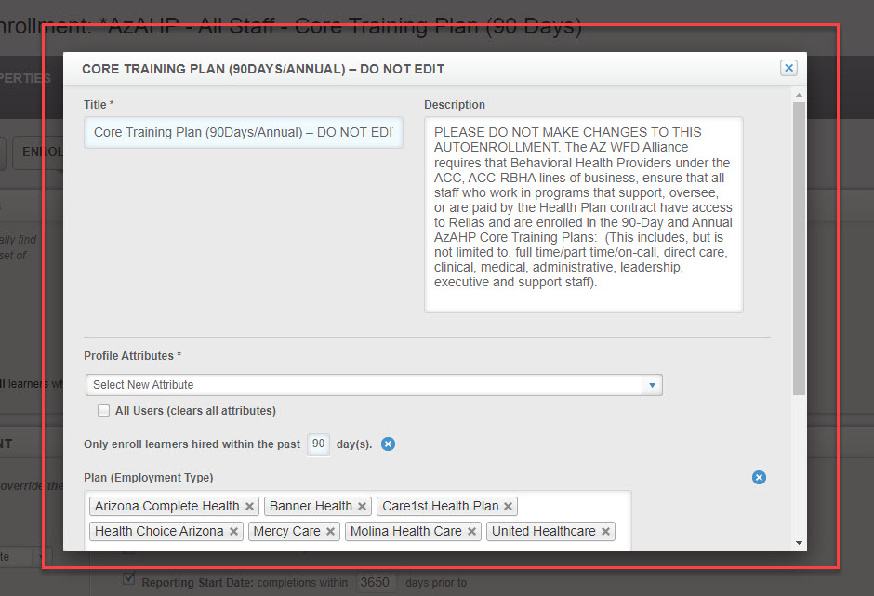
Relias Updates
AzAHP Standardized Autoenrollment Profiles Rollout
Automated enrollment profiles have been enabled for the two required AzAHP training plans (both 90 day and annual).
Please do not modify/delete the autoenrollment profile shown:
Upcoming Relias Webinar CSM Led Training Workshop Opportunities
Joe will be hosting two workshops coming up in February:
What: Supervisor Navigation Workshop for SPP Supervisors
We will be reviewing essential functions for those who have Relias Supervisor Permissions. More details to come!
When: Tuesday, February 6 from 11-12PM AZ Time
Where: Click to Join Here
What: CFT Competency Evaluation Workshop
We will be reviewing the competency evaluation tool, specifically focusing on the CFT process/evaluations.
When: Wednesday, February 21 from 11-12PM AZ Time
Where: Click to Join Here

Slide 16
Relias Updates
Relias Resources/Toolkit Available in Website
You can find the supporting resources here:
Relias Toolkit - Best Practices for Completion/Compliance - Arizona Association of Health Plans (azahp.org)
Revitalize Your Relias Site.
How to Get Ready for the New Year.
Administrator and Supervisor Checklists.
Learner Supporting Resources:
This includes documentation and supporting resources on Login Assistance, Password Recovery, Introducing Relias, Guide for New Learners, License and Certification Entry, and Learner Mobile Application!

Slide 17
Relias Updates
Policies and Procedures Tool Now Available
With the Policies and Procedures tool, you can see, create, and manage policy/handbook documents your Learners need to read and attest to.
Located under the "Learning" tab in the left-hand navigation pane.
Resources are available in Relias Connect.
Upcoming Webinar Opportunity
What: Becoming a Trauma-Informed Organization: Best Practices for 2024
When: Wednesday, January 31, 2024 · 2:00 p.m. EST
Learning Objectives: Identify the basic components of trauma and the key elements of the trauma-informed care framework. Compare and contrast the roles of individual providers and organizational leaders in addressing secondary trauma. Create a toolkit of resources to support healthcare worker’s emotional wellness and compassion satisfaction. Develop strategies for implementing TIC on a system and community-wide level within the healthcare organization.
Registration Link: https://webinars.relias.com/relias/becoming-a-trauma-informed-organization-best-practices-for-2024?_gl=1*1ktrdi6*_ga*ODA1NzQzMDQyLjE2NjM2Nzk2MDk.*_ga_5P05WVNGPN*MTcwNDQwNTQzNi43Ny4wLjE3MDQ0MDU0NzQuMjIuMC4w&_ga=2.146442161.48671100.1704405437-805743042.1663679609

Slide 18
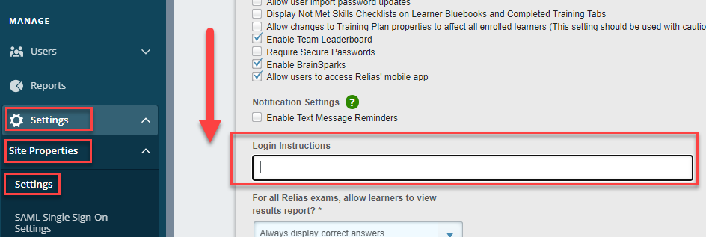
Relias Tips/Tricks
Updating Login Instructions
• You can alter your login landing page by adding login instruction language above your Username and Password for learners to see! This is a great location to place Learner Support information in case if they need login help. Relias Administrators can navigate to their Site Settings page and can update the login instructions from there. You can use page breaks using HTML code!! Feel free to utilize the login instructions below for your own Relias Portal!
Before clicking on "Help" ... navigate to the link below to watch a video to learn how you can reset your password yourself if you need to: https://youtu.be/OqlKGODJaR4. <br /><br /> You also have access to Relias Learner Support which is available to you from Monday-Friday from 8AM-8PM EST! Visit the below link for contact options/information <br /><br /> https://connect.relias.com/s/learner-page/aA13w000000k9xdCAA/paid-learner-support-page-for-arizona-association-of-health-plans-inc

Slide 19
Relias Administrative Mastery Program (RAMP)
RAMP is a training plan program for Relias Administrators that covers site and overview, user management, hierarchy, courses, training plans, and reporting in the Relias Platform that is available in your training plan list for Relias Administrators to self-enroll into!
Navigate to your Training Plan List from your Relias Administrator profile and search for "RAMP" if you would like to self-enroll.
The courses will take between 30-90 minutes and include knowledge checks throughout to aid with knowledge retention.
Become certified as a Relias Administrator upon completion!

Slide 20
Relias Office Hours
Have questions or new to your role? Relias CSM, Relias Connect, & Relias Support by your side!
Enterprise Client Success Manager
Joe Chemali
jchemali@relias.com
Relias Technical Support
1-800-381-2321
Hours of Operation: Mon – Fri (8 AM - 8 PM EST)
Relias Connect
AzAHP Learner Support
1-833-224-4008
Hours of Operation: Mon – Fri (8 AM - 8 PM EST)
Link to Resource: https://connect.relias.com/s/learner-page/aA13w000000k9xdCAA/paid-learner-support-page-for-arizona-association-of-health-plans-inc

Slide 21
BRAIN BITES
SMART Goals
Jodi Stone - AZ Center For Change

Slide 22
Targeted Goals and SMART Objectives to Impact Care

Slide 23
TRAINING OBJECTIVES
Identify how goal setting is an essential element of the Golden Thread.
Identify the concept of targeted goals.
Identify the importance of creating specific, measurable, achievable, relevant and time bound objectives.
Demonstrate examples of poorly written vs well written objectives.

Slide 24
The Golden Thread
The first step in effective goal writing is ensuring that the reason for referral or client’s need(s) align(s) with the identified treating diagnosis and recommendations from the Clinical Assessment.

Slide 25
Treating to Target
Treating to Target
Develop a list of desired outcomes (goals)
Triage the desired outcomes
Limit the amount goals in each treatment plan
Identify action steps to accomplish to accomplish desired outcomes (objectives)
Once a goal is accomplished – add another- rinse and repeat.
Best Practices
Helps focus and organize clients and families
Creates reinforcement of success of client as well as the clinician
Creates a space to evaluated effectives of a goal when necessary, without creating a disconnect with other desired outcomes

Slide 26
Objectives:
Once the desired outcome is identified, one creates action steps designed to move clients closer to achieving a goal.
What specifically need to happen (step by step) for this outcome to be achieved?
How will one know when the action step is met?
Are these action steps something this individual can rise to emotionally, economically, physically and/or safely?
Is this action step relevant to the treating diagnosis and recommendations for care?
How long is a reasonable amount of time to achieve this action step?

Slide 27
Examples of Poorly Written Objectives:
Goal | Objectives
Client will achieve financial independence | Be better with money Will watch videos for guidance on money management Get better grades in school
Client will reduce or eliminate trauma symptoms | Reduce conflict in relationship Increase positive emotions and use coping skills Client will come to treatment
Client will establish safety in the household | Client will stay away from unhealthy partners Client will apply healthy relationship skills Client will stop spanking her children

Slide 28
Examples of Well Written Objectives:
Goal | Objectives
Client will achieve financial independence | Client will take a budget class online within the next 15 days. Client will draft a workable budget to utilize for 30 days. Client will create a working list of employment opportunities that fit with her training and experience Client will apply for three employment opportunities each week once list is created.
Client will reduce or eliminate trauma symptoms | Client will complete trauma timeline within 5 therapy sessions. Client will identify 3 coping skills to manage distressing memories. Client will practice the 3 identified coping skills to manage distressing memories Client will complete a brief trauma assessment every other month to confirm reduction in trauma symptoms.
Client will establish safety in the household | Client will identify at least 5 characteristics of intimate partners that pose a safety risk to her children within first 4 sessions. Client will identify at least 3 effects of physical and verbal violence on her children within 8 sessions Client will create a written workable safety plan for her family by court date set for March 2024.

Slide 29
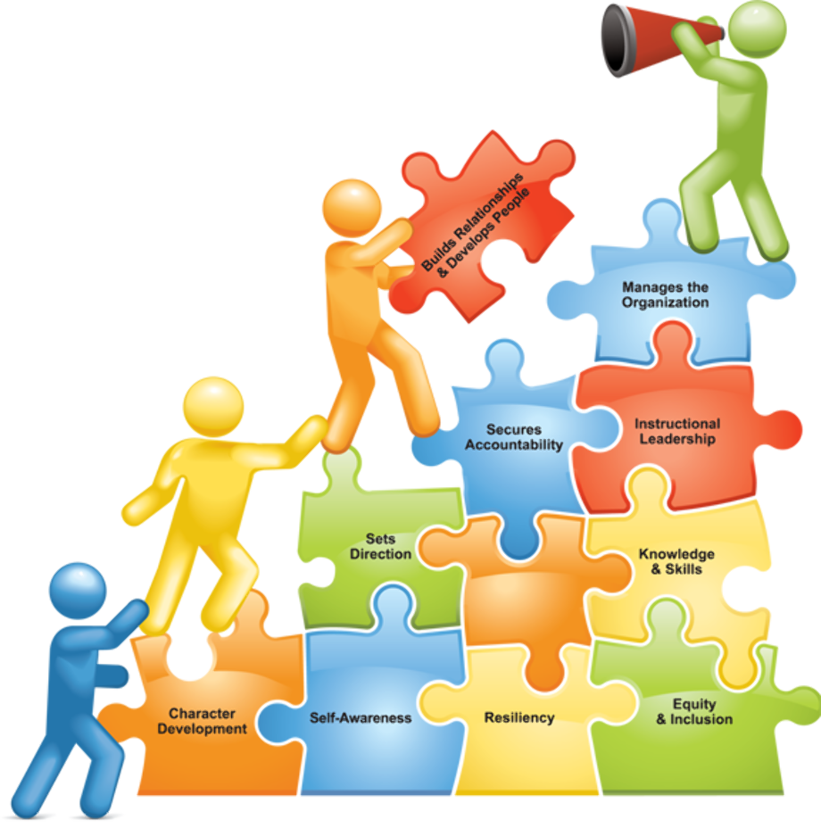
Provider- Workforce Development Plan (P-WFDP) Template

Slide 30
2024 P-WFDP Template
We are excited to announce the 2024 Provider-Workforce Development Plan (P-WFDP) template! Based upon Provider feedback and analysis conducted by the AZ WFD Alliance (ACC, ACC-RBHA), this year's iteration uses targeted questions that are more responsive to the needs of the Arizona Network. This year’s process will continue to use JotForm, an online platform, which allows the user to save progress and generate a shareable link to collaborate with internal team members.
Template Release Date: October 12th, 2023
Competency Continuum Release (scoring rubric): December 2023
Extension/Exemption Request Deadline: January 15th, 2024
Due Date: February 1st – February 29th, 2024
“The future of organizations is the growth of the people in them.” - Unknown
New This Year: Agencies that participated in the 2022 AHCCCS DAP and/or received “EXEMPLARY” status on their 2023 P-WFDP submission may elect to submit a shortened form (V2) of the 2024 Provider-Workforce Development Plan (P-WFDP) that focuses on WFD goals. As an option Providers may choose to submit the full form (V1), instead, if they would like to update their WFD initiatives in all areas (including WFD goals, succession planning, culture and employee competency).
Version 1 (V1)
vs.
Version 2 (V2)
P-WFDP Resources: Click Here

Slide 31
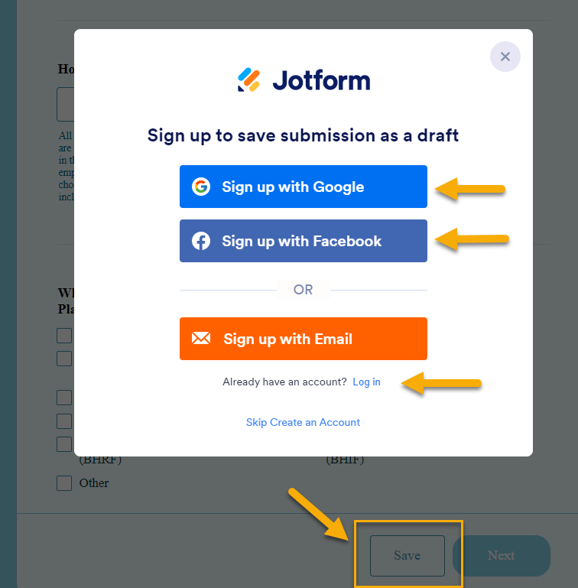
2024 P-WFDP (Jotform) Template
Instructions:
P-WFDP Resources
Click “Version 1” or Version 2”
Enter your agency name at the top of the form
Scroll to the bottom of the template and select “Save”
Create an account or Login to your existing account
Save the “Sharable” Link that is generated
If you do not save this link the WFD Alliance cannot recover information you have entered on the form.
You can share this link with trusted team members that will be helping you develop your P-WFDP
“The future of organizations is the growth of the people in them.” - Unknown

Slide 32
2024 P-WFDP Workshops
Course Name: *AzAHP - Provider Workforce Development Plan (P-WFDP) Workshop
Register: Relias (search “workshop”) in your Module List
NOTE: You can only register for 1 session at a time
01/25/24 1:00 – 2:30pm (Thursday)
02/14/24 3:00 – 4:30pm (Wednesday) ❤
Agenda:
1st Hour: Review the entire P-WFDP Template in a large group
Break-Out Sessions: To review individual agency questions with a member of the WFD Alliance
“The future of organizations is the growth of the people in them.” - Unknown
Additional Supports:
1:1 Consultation by request: The WFD Administrators are available for consultation via email, phone, or webinar. Please contact us as needed to schedule a meeting.
Competency Continuum: This is the tool that the WFD Alliance utilizes to provide each agency with feedback for their P-WFDP submission. A blank copy of this form will be posted to the AZAHP website by December to help guide and prepare your agency for submission of the plan. P-WFDP Templates Resources: Click Here

Slide 33
Legacy Agency Spotlight
Legacy Agency Spotlight: An opportunity to recognize your agency or others for outstanding achievements related to workforce development made within the last 6 months.
Review/Process: The Arizona WFD Alliance is currently in process of reviewing submissions
Winners: The Winner and Honorable Mention(s) will be announced at a Provider Form (in February) and recognized with a "Certificate of Achievement" on the AzAHP website.

Slide 34
AZ Healthcare Workforce Goals and Metrics Assessment (AHWGMA)
The AHWGMA is a statewide data collection tool used to help the Arizona Network by gathering information, analyzing data, and assessing the current and future needs of the workforce. The results of this process gives insight for future funding opportunities, highlights where support is needed, and assists with the prioritization of initiatives/projects across the network.
The AHWGMA is a collaborative effort initiated by the Arizona Workforce Development (WFD) Coalition, which includes Workforce Development Administrators from all 9 Arizona Managed Care Organizations (MCO’s). Together the Coalition ensures initiatives across the state of Arizona align with all respective lines of business (ACC, ALTCS, DD, DCS CHP, DES/DDD, RBHA).
Release: April 16, 2024
Close: May 31, 2024
Contractually Required: YES
(See your contracted HP’s Provider Manual)
Language around the AHWGMA can be found in your contracted Health Plans Provider Manual. For the list of required Provider types please visit the AZAHP website
Notes:
It is our responsibility as a Contractor to produce a Network Workforce Development Plan for each line of business (ACC, ALTCS E/PD, DCS/CMDP, DES/DDD, CMDP, and RBHA). A portion of this is currently being supported by the AzAHP Provider Workforce Development Plan.

Slide 35
AZ Healthcare Workforce Goals and Metrics Assessment (AHWGMA) Webinar
Forecasting the Future Needs of the Arizona Healthcare Workforce
Join the Arizona Workforce Development Coalition for an engaging and informative online webinar where we will delve into the 2024 AZ Healthcare Workforce Goals and Metrics Assessment (AHWGMA).
**Who should attend: Any Organization with an AZ Medicaid (AHCCCS) Contract on this list of AHCCCS Provider Types.
This webinar is designed to give a high-level overview of this statewide initiative, review the questions on this year's iteration of the assessment, and provide an opportunity to ask questions and gain a deeper understanding of the goals and metrics that are crucial for success of the Arizona Healthcare Workforce.
We look forward to seeing you at the AZ Healthcare Workforce Goals and Metrics Assessment (AHWGMA) Webinar!

Slide 36
3 Webinar Sessions Available
3/5 - Tuesday @ 2pm - 3pm
3/21- Thursday @ 11am - 12pm
4/2- Tuesday @ 10am -11am
Click on the Date you would like to register for
Notes:
Microsoft Forms

Slide 37
Child and Family Team Policy Update
580 - Child and Family Team
Attachment A - Strengths, Needs, and Culture Discovery Domains
Attachment B - CALOCUS Implementation Guidelines for CFT Practice Nine Essential Activities
Attachment C - Child and Family Supervision Tool
Attachment D - Arizona Child and Family Teams Supervision Tool Users Guide
Attachment E - Implementation of 12 Principles for Children's Behavioral Health Service Delivery

Slide 38
Competency Evaluation Tool (AHCCCS Supervision Tool)
AMPM 580 Attachment C & D have been updated and are live as of December 2023
90 Day, 6-Month, and Annual Competency Evaluation Tools have been updated
There are 34 Targeted Competencies versus 56 Targeted Skills/Competencies
PLEASE ENSURE all Observations are complete by January 31, 2024
February 1, 2024- ALL employees enrolled in the current plans will me moved over to the new corresponding ones

Slide 39
Creating Pathways
To In-Demand Careers
The Future of Healthcare Recruitment
Notes:
Azhealthcarecareers.org
If you are not aware of it already.
AZ Healthcare Careers is a collaborative tool developed through a partnership between Pipeline AZ and AHCCCS (Arizona Health Care Cost Containment System).
AZ HC Careers address the pressing need for healthcare talent in the state by providing a platform for students and job seekers to explore healthcare career opportunities.
Compliments other ARP initiatives

Slide 40
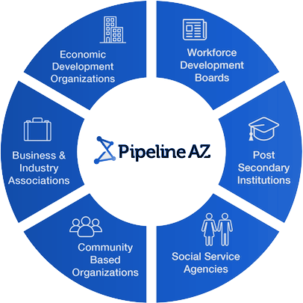
About AZ Healthcare Careers
Where Arizona job seekers, students, employers, educational institutions, and non-profits come to build Arizona’s healthcare workforce.
Career pathway awareness
Opportunities for exploration related to users’ interests
Job opening matches based on users’ skills
Information and planning tools for education and industry-recognized credentials
Match and map career pathways to skilled candidates through a company page and free job posts
Tracking for workforce organizations
Notes:
AZ Healthcare careers is the only locally built community-wide solution for workforce development and tracking in Arizona.
AZ Healthcare Careers uses skills mapping technology to connect job seekers with Arizona career information and opportunities that are personalized to experiences, skills and interests.
Equitable Access to Career Exploration
Singular Technology Infrastructure
Feedback Loop Between Industry and Education
AZ Healthcare Careers allows students and job seekers to build a profile, take a jobs skills assessment, and explore health care career opportunities.
The platform highlights healthcare occupations that require minimal experience or training, making them viable entry-level positions.
From an entry-level position like a behavioral health technician or CNA, the platform outlines career advancement and training pathways that help employees to move up into in-demand positions like healthcare social workers, registered nurses, and more

Slide 41
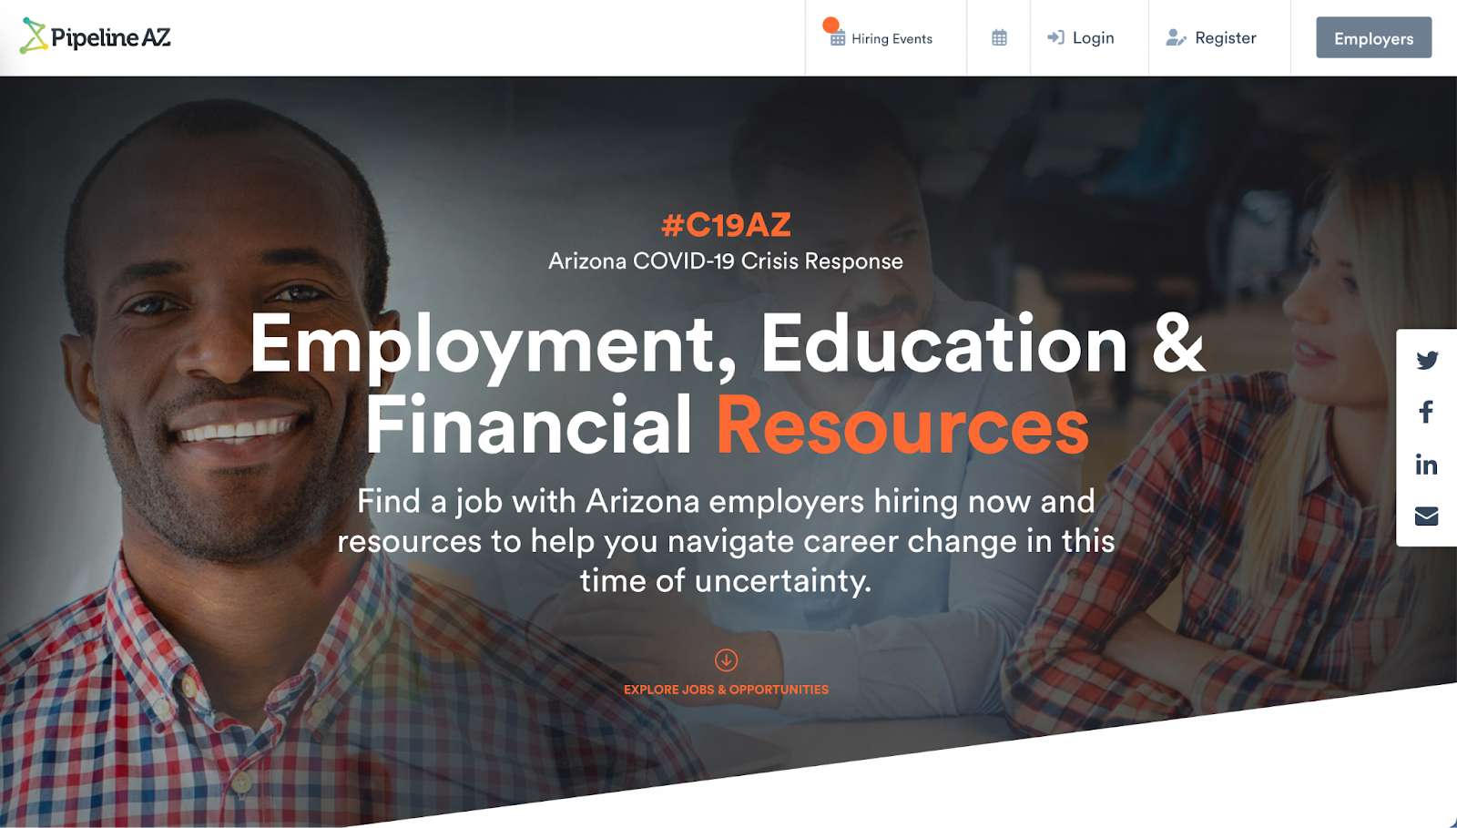
Pipeline AZ is The Singular Source for AZ’s Workforce
Pipeline AZ is the career readiness platform for the Arizona Department of Education, as well as multiple colleges and universities in Arizona. It is the single connection point between industry and Arizona’s workforce, creating a continuous talent pipeline.
K12 Students
Post Secondary Students
Return-to-Work and Transitioning Workers
Industry Workforces
Notes:
My Future AZ = K12
Maricopa Pipeline = MCCCD
Central AZ Pipeline = CAC
Yavapai Pipeline = Yavapai College
Coconino Pipeline = Coconino College
Arizona Western Pipeline = Arizona Western College
Many connection points into education industry, community
Reading levels are specific to each bracket of users. We have a middle grades version, a high school version, a community college version, and a version for adult users: incumbent workers and the general public.
The site has been designed to allow for content to be specific to each audience. For example, day in the life videos for middle school can be higher level versus more detailed content for high school learners.
K12 Students
Pipeline AZ provides resources for K-12 students to explore, prepare, and connect with career pathways and the next steps for their futures. MyFutureAZ.com is the preferred platform the Arizona Department of Education’s ECAP standards for all Arizona students.
Post-Secondary Students
Pipeline AZ offers resources to university, community college and career/ technical students that provides customized career and education exploration and planning framework. Our white-label-platforms provide field of interest and career guidance for students and their advisors, while creating a connection point between industry and career-ready students.
Return-to-Work and Transitioning Workers
Our unique public/private partnerships provide resources to a diverse range of individuals across Arizona. The platform is a resource for all Arizonans, including those returning to the workforce, to unique initiatives in rural Arizona, to people transitioning from other fields, as well as those suffering from financial hardship because of job loss.
Industry Workforces one of three hubs, cy, HTL
Pipeline AZ supports initiatives that help individuals succeed in healthcare careers, including training programs, mentorship opportunities, and resources tailored to specific groups.

Slide 42
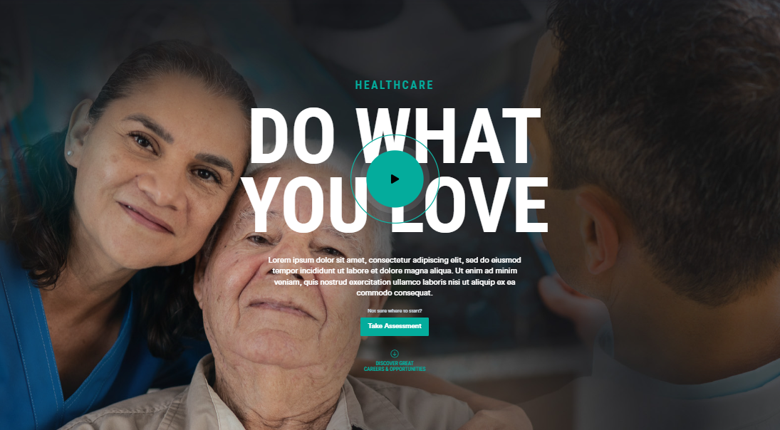
Industry Platforms Create Spaces for Talent Attraction
AZ Healthcare Careers inspires and engages students and job seekers through stories, tools, and opportunities that highlight career paths and job seeker to employer connectivity.
Notes:
Emotional and Logical Appeal
—----
AZ Healthcare Careers is not only about logical career planning but also fostering emotional connections to the healthcare profession.
We recognize Healthcare is not just a profession but a calling, AZ Healthcare Careers serves as the single source or truth, providing a central repository of information for aspiring healthcare professionals.
Our commitment to empowering the next generation includes providing essential career data and educational pathways to prepare them for the future workforce.
We break down barriers, create easy entry points, and enhance career awareness, facilitating connections between education and high-demand industry roles, and ensuring direct outreach to employers in need.

Slide 43
Key Features AZ Healthcare Careers
Profile Building: Users can create profiles to showcase their skills and qualifications.
Skills Assessment: Offers a job skills assessment to help users identify suitable career options.
Entry-Level Opportunities: It highlights healthcare occupations that require minimal experience or training, making them accessible entry-level positions.
Career Advancement: AZ Healthcare Careers outlines career advancement and training pathways for users, helping them progress to in-demand positions.
Matching Tool: It assists healthcare providers in matching job openings with candidates who possess the required skills and training.
Notes:
Launched in June 2023, The platform is continually evolving.
AZ Healthcare Careers is not only a short-term solution but also a long-term workforce development strategy. It connects with educational programs at the K-12 and college levels through My Future AZ, a tool offered in partnership with the Arizona Department of Education.
This enables users to explore healthcare career pathways and create college and career plans.
Additionally, partnerships with Arizona's community college systems provide healthcare students with opportunities for work-based experiences like internships, helping them meet graduation requirements and gain real-world work experience.
Key Features Include:

Slide 44
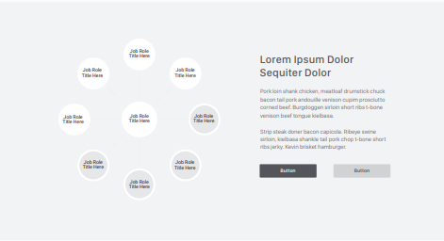
Development In Motion: Career Path
Build each career from:
Tab “Lattice Content”, “Next Ring”
https://docs.google.com/spreadsheets/d/1st8knz0A9LJnqJ198o9sW1nlmNhu84GO/edit#gid=1987484697
DSP
CNA
CHW
Add Copy:
Find Your Path to Success
Get and idea of what your career path could look like for a Direct Care Worker.
BHT
DCW
Peer Support
Billing and Posting Clerks
Certified Caregiver
Change Button:
Copy-“Get Started Today”
Color-AHCCCS Style Guide
Link to: https://pipelineaz.com/sign_up?return_to=%2Fhubs%2f Healthcaresource=paz_healthcare_hub
MA
Change Copy and Color: Copy “Current Openings” Button color, AHCCCS Style Guide
Jobs Postings to pull with common used names:
Direct Care Worker, Direct Support Professional, Professional Caregiver, Attendant Care Provider, Personal Care Aide, Respite Care Provider, Home Care Worker, In-Home Care Provider, Companion Caregiver, Care Technician, Support Worker, Home Attendant, Live-In Caregiver, Personal Care Assistant, Caregiver, Mentor, Residential Aide, Life Skills Coach, Community Support Specialist, Supported Living Assistant, Vocational Support Specialist, Rehabilitation Specialist
Notes:
Path Intro

Slide 45
Chief Executives
Substance Abuse and Behavioral Disorder Counselors, Mental Health and Substance Abuse Social Workers,
Mental Health Counselors
RN
Healthcare Social Workers
Masters
Bachelors
Medical and Health Services Manager
LPN
Case Manager, Case WOrker,
Social and Human Service Assistants, Child, Family, and School Social Workers
CNA
MA
First Line Sup
Cert Caregiver
Billing and Posting Clerks
DCW, DSP, Home Health Aide
Peer, BHT,
CHW
DSP
Diagnostic
General Management/Business Management
Therapeutic
Human Services

Slide 46
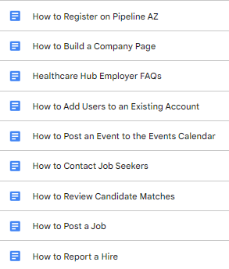
Employer Onboarding and Media Kit
Executive Director/CEO
Psychiatrist/
Psychologist
Licensed Clinical Social Worker
Mental Health Counselor
Social Workers
Disability Counselor
Program Manager

Slide 47
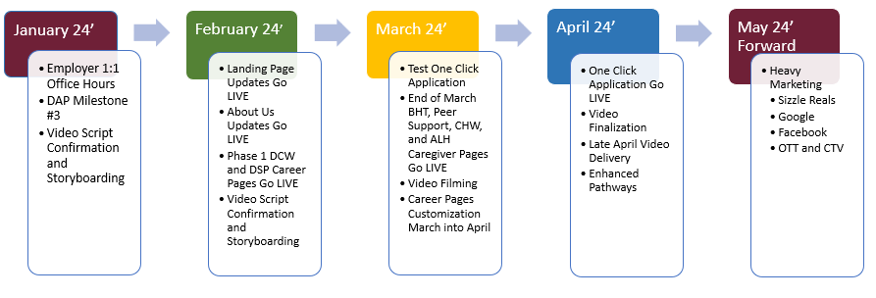
Development: Timeline
*Standard occupation Day in Life and Skill Videos added
Notes:
Phased Dev Timeline
DAP-Milestone #3 posting relevant and current open roles within your company on Pipeline AZ.
As part of the guidelines, 50% of the roles are required to be entry-level roles
DIL
Skills/Tasks
Testimonials
Sizzle Reals for pages and general marketing
Testimonials LINK https://docs.google.com/forms/d/e/1FAIpQLSfpGftBNe4RK1Tlcdf28iKguVGMO6sP-R94AJMkGy-bJUrQbA/viewform?usp=sf_link

Slide 48
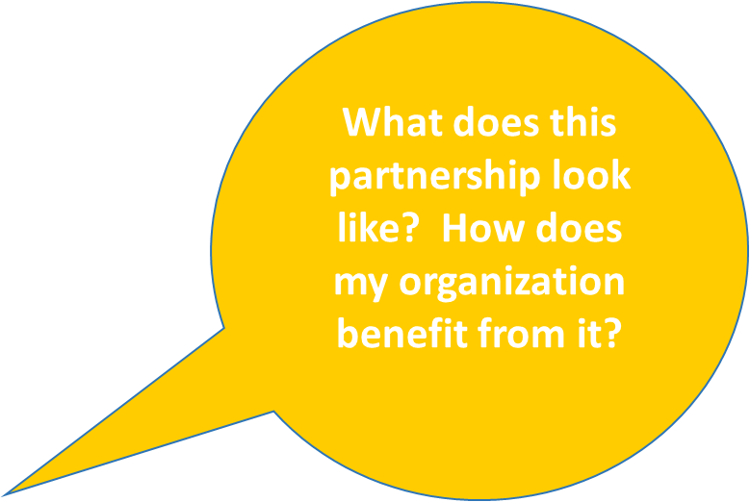
Action: Office Hours for 1:1 Support
Select a Date & Time - Calendly
Testimonials Link: Career Profile Template
What is a
“Roadshow”
and how do
I get one?
Notes:
https://calendly.com/klemke-paz/45min
Employers 1:1 support

Slide 49
2023 Q4 Course Completion Report
Quarter 4 reports will be run January 31, 2024
This is the time to run your own agency report and reach out to your staff and confirm they have completed the required learning.
Notes:
2023 Q3 Course Completion Report Results are available at www.azahp.org
<AZ Workforce Development Alliance – ACC, ACC-RBHA
< Provider Resources
< Quarterly Completion Reports (bottom of page)
< Access Quarterly Completion Archives
< Quarter 3, 2023

Slide 50
Best Practices in Workforce Development
AHCCCS— Professional Development initiative is a unique opportunity that will focus on professional development and competency-building for behavioral health workforce development and training staff.
As the nature of work continues to change at an unprecedented pace, professionals in workforce/talent development and training roles, must too, adapt and continuously improve themselves to unlock their full potential to drive impact.

Slide 51
Best Practices in Workforce Development
AHCCCS has partnered with the Association for Talent Development (ATD) to provide expert-led professional development programs at no cost to eligible Arizona Medicaid providers who deliver Home and Community Based Services (HCBS) to enrolled AHCCCS (Medicaid) members. For more information, visit the AHCCCS Website:
Workforce Development Programs for AHCCCS providers.
ATD Training and Facilitation Certificate Program. This virtual, live instructor-led program is one of ATD’s most popular train-the-trainer offerings, and helps new and seasoned trainers become learner-centric facilitators who apply the skills of an engaging and effective trainer.
ATD Integrated Talent Management Certificate Program. In this virtual, live instructor-led talent management program, participants will uncover the practices essential to achieving a successful integrated talent management approach for their organization. This program is intended for workforce development professionals, HR professionals, or leaders actively involved in workforce development activities.

Slide 52
Best Practices in Workforce Development
We invite you to join upcoming Lunch and Learns, to learn more about these programs
Who should attend, why you should attend, and what you can expect to learn
30-minute sessions with time for Q&A
Optional; Attend one or both
.
Jan 24, 2024 11AM – 11:30 AM: Training & Facilitation Lunch and Learn: http://atdeducation.adobeconnect.com/r8o5e2rk1pl6/
Jan 24, 2024 12PM – 12:30 PM: Integrated Talent Management Lunch and Learn: http://atdeducation.adobeconnect.com/itmllahcccs/

Slide 53
R & R Reminders and Resources
Training of the Month
*AzAHP – HIPAA Basics (Due Jan. 31st)
AHCCCS is Building the Health Care Workforce
ARP WFD Initiatives
https://www.azahcccs.gov/AHCCCS/Initiatives/ARPA/ARPScholarships.htm
https://www.azahcccs.gov/AHCCCS/Initiatives/ARPA/HCBSCourses.html

Slide 54
Open Discussion: Questions, Suggestions, Ideas & Feedback

Slide 55
Closing/Next Meeting
Next meeting: February 8th, 2024 11:00 AM – 12:30 PM

Slide 56
Thank You!

