Slide 1









Arizona Workforce Development Alliance (ACC, ACC-RBHA)
FEBRUARY 2024 Provider Forum

Slide 2


Our Mission
To evaluate, monitor, and support the development of the Capability, Capacity, Connectivity, Culture, and Commitment of our provider workforce leading to a competent workforce that is capable of producing optimal member outcomes.
McDowell Mountain Preserve

Slide 3
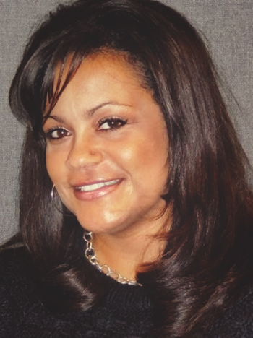




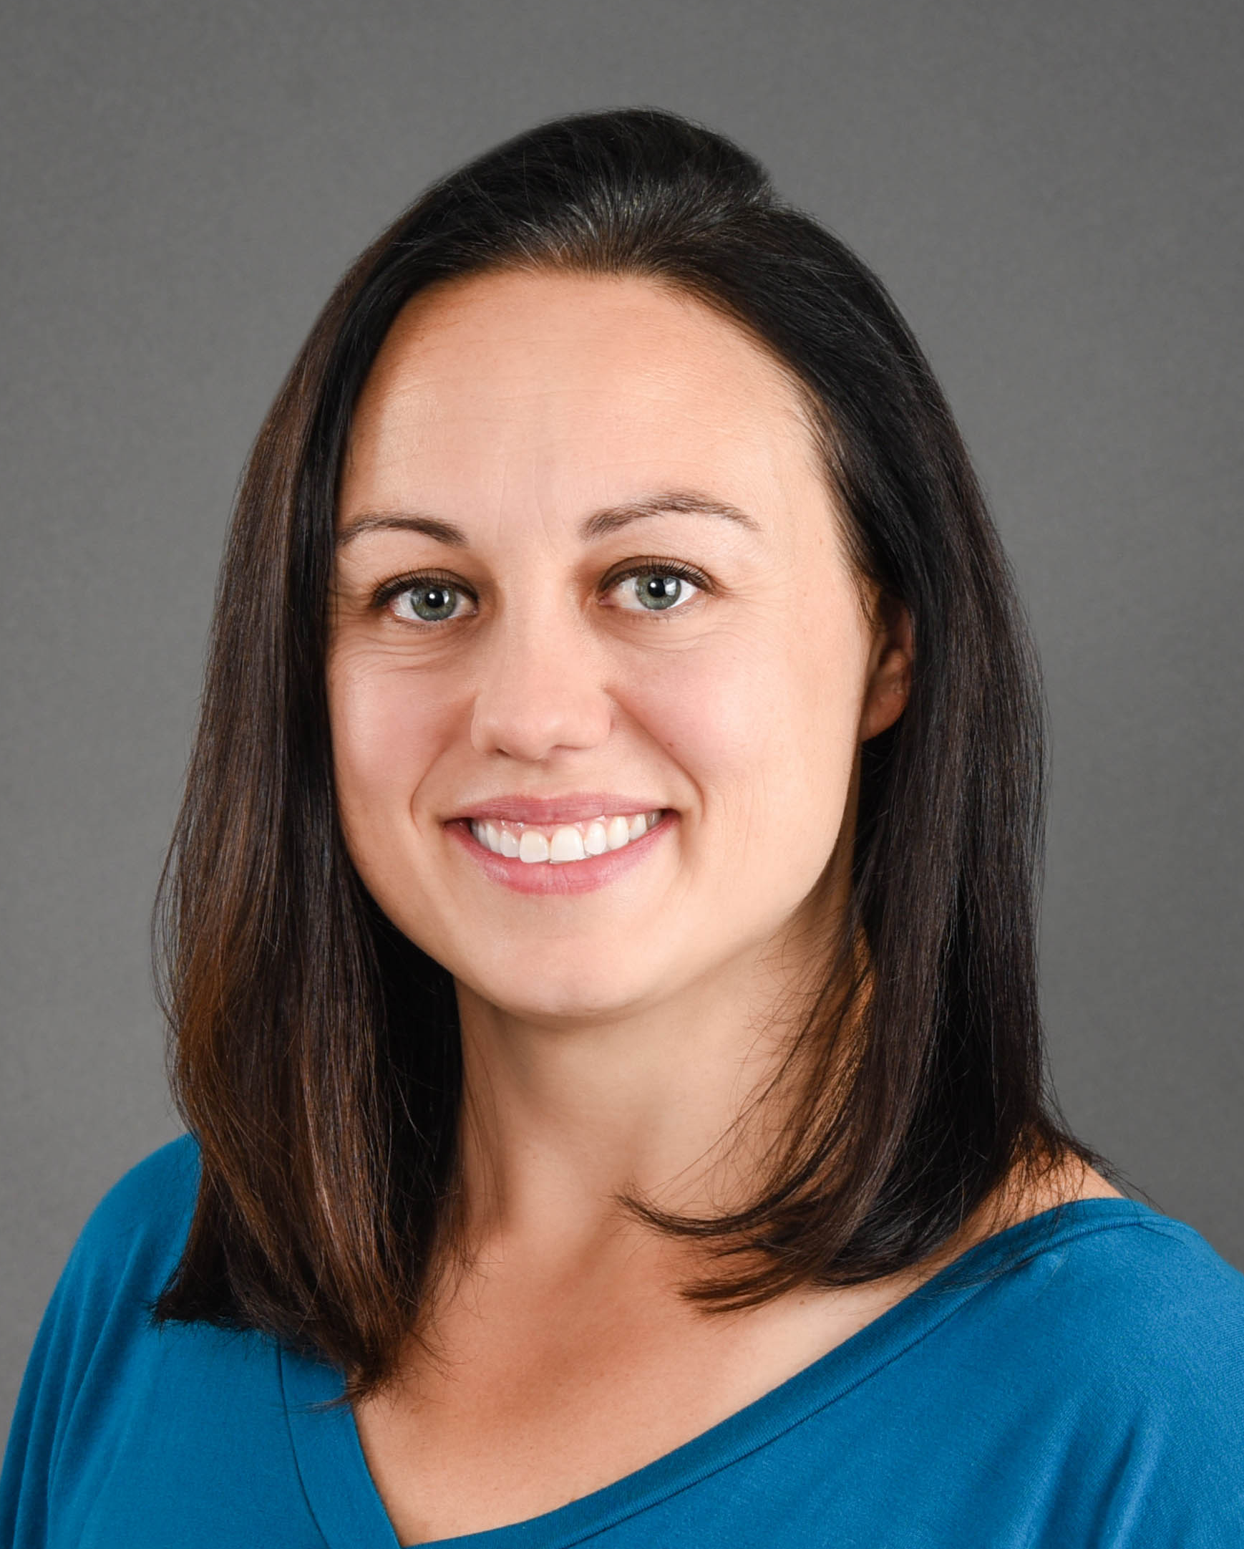

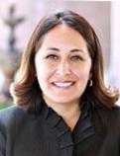

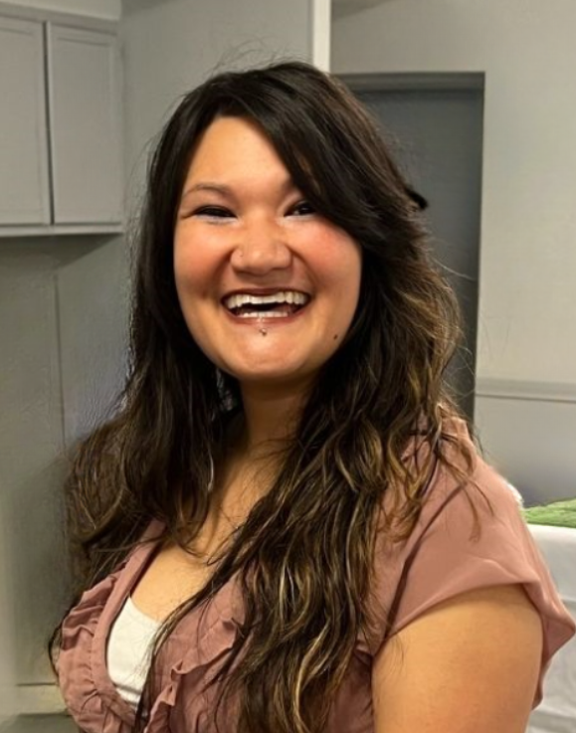
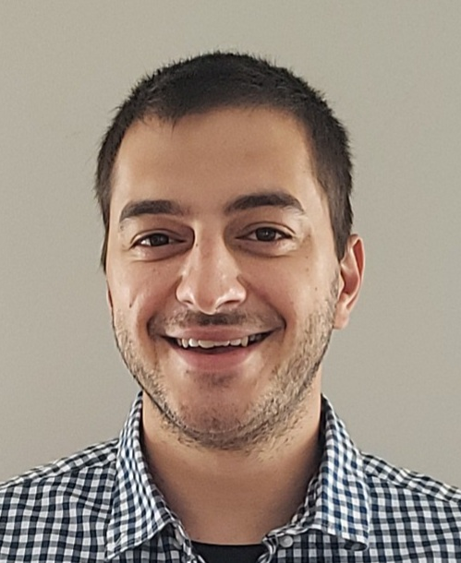
Arizona Workforce Development Alliance Members
Yvette Tucker
Arizona Complete Health
Workforce Development Administrator
ACC-RBHA
Selena McDonald
Banner - University Health Plans
Workforce Development Administrator
ACC
Cori McLain
Banner - University Health Plans
Workforce Development
ACC
Mark Faul
Care1st Health Plan Arizona
Workforce Development Administrator
ACC-RBHA
Jennifer Elkins
Health Choice Arizona
Workforce Development Administrator
ACC
Sarah Hauck
Mercy Care
Workforce Development Administrator
ACC-RBHA, ALTCS, DD, DCS/CHP
Mike Tripp
Mercy Care
Workforce Development Manager
ACC-RBHA, ALTCS, DD, DCS/CHP
Veronica De La O
Molina Health Care
Workforce Development Administrator
ACC
Layla Bishop
UnitedHealthcare Community Plan
Workforce Development Administrator
ACC, ALTCS & DD
Sylvia Sanders
Arizona Association of Health Plans
Consultant / Workforce Development Program Manager
Joe Chemali
Relias
Enterprise
Client Success
Manager
Notes:
Our WFD team is growing and we have added a few new members to our team this year, because we have so many big projects and initiatives we are working on.

Slide 4

Reminders & Resources (RnR) – Veronica D.
Training Opportunities – Layla B.
Quarterly Reporting – Sarah H.
Relias Update – Joe C.
Heritage, History & Health Observances – Alejandra P., The Guidance Center
CALOCUS – Layla B.
CFT Updates– Layla B.
Housing 101 Resources and Referral Guide - Erin L., United
P-WFDP Reminder & Workshops – Sarah H.
Collaborative Conversations – Roberto V., South Mountain Community College
DD Spotlight – Nia U., Arizona Autism United
Brain Bites – Staff Development & Recognition – Pamela W., Horizon Health and Wellness
Best Practices in Workforce Development ARP Funded Initiative – Cori M.
Legacy Agency Spotlight: Winners & Honorable Mentions – Laura S., COPE Community Services
DDD ARP Initiative Update- Layla B.
AGENDA

Slide 5


Announcement
We are switching to Teams for all future AzAHP Provider Forums, effective in March 2024!!
Same Time: 2nd Thursday of the Month from 11am-12:30pm MST
**Be sure to create a new reoccurring invite on your calendar with the link below!
https://teams.microsoft.com/l/meetup-join/19:meeting_ZDBjMTU5MTAtMzJkNC00MDliLTljNDgtOTVmOGVmZWRhZmEx@thread.v2/0?context=%7B%22Tid%22:%224e6b076a-1c16-42e3-a8ea-752686e1424d%22,%22Oid%22:%224031f37a-6f0b-4ca9-97b7-6ccf06c7b467%22%7D

Slide 6



Heritage, History & Health Observances
Black History Month (African American Heritage Month)
  https://blackhistorymonth.gov/ This Site Hosted by The Library of Congress
  https://africanamericanbehavioralhealth.org/HealingHistory.aspx African American Behavioral Health Center of Excellence
American Heart Month
  https://www.heart.org/ American Heart Association
  https://azheartfoundation.org/february-is-american-heart-month/ Arizona Heart Foundation
Lunar New Year (Spring Festival or Chinese New Year) – begins February 10
Valentine’s Day – February 14
*Not an all-inclusive list

Slide 7
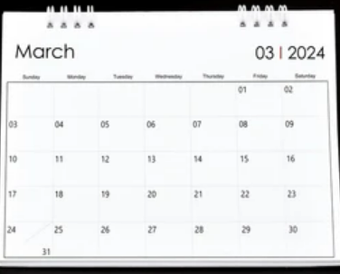


Heritage, History & Health Observances
Women’s History Month
Irish American Heritage Month
Developmental Disability Awareness Month
Colorectal Cancer Awareness Month
National Nutrition Month
National Kidney Month
Cesar Chavez Day –March 31
*Not an all-inclusive list
By nurturing a culture that prioritizes Diversity, Equity, & Inclusion- your organization can unlock many advantages ranging from enhanced productivity, to bolstered retention rates, to improved member outcomes.

Slide 8
Relias Updates- AzAHP Training Plans
***As a reminder, it is required that Behavioral Health contracted ACC/RBHA Providers must ensure that all staff who work in programs that support, oversee, or are paid by the Health Plan contract have access to Relias and are enrolled in the AzAHP AzAHP – Core Training Plan (90 Days) and the AzAHP – Core Training Plan (Annual) training plans. This includes, but is not limited to, full time/part time/on-call, direct care, clinical, medical, administrative, leadership, executive and support staff. Quarterly reporting is completed by the WFD Alliance to check on completion metrics for these two training plans.***
AzAHP – Core Training Plan (90 Days)
*AHCCCS – Health Plan Fraud (0.75hrs)
*AHCCCS – NEO – Rehabilitation Employment (0.5hrs)
*AzAHP – AHCCCS 101 (2.0hrs)
Supporting Client Rights for Paraprofessionals in Behavioral Health (1.0hrs)
*AzAHP – Cultural Competency in Health Care (1.0hrs)
*AzAHP – Quality of Care Concern (1.0hr)
Basics of Corporate Compliance (0.5hrs)
HIPAA: Basics (0.5)
Integration of Primary and Behavioral Healthcare (1.25hrs)
AzAHP – Core Training Plan (Annual)
HIPAA: Basics (0.5hrs)
Preventing, Identifying and Responding to Abuse and Neglect (1.0hrs)
Basics of Corporate Compliance (0.5hrs)
*AzAHP – Cultural Competency in Health Care (1.0hrs)
*AHCCCS – Health Plan Fraud (0.75hrs)
*AzAHP – Quality of Care Concern (1.0hr)
Please reference the "AzAHP Core Training Plans" document for exceptions and further information which is available under the "Provider Resources" tab in AzAHP's website.
***AzAHP Standardized Autoenrollment Profiles Applied to Both Training Plans Titled "Core Training Plan (90Days/Annual - DO NOT EDIT)***

Slide 9
Relias Updates- CFT Competency Evaluation Tool
CFT Competency Evaluation Updates
    Legacy CFT Competency Evaluations have been retired.
    Three Updated CFT Competency Evaluations have been shared throughout the AzAHP Enterprise and learner enrollments that were not overdue were transferred over to the updated corresponding CFT Competency Evaluation (90 day, Six Month, and Annual). This means that all overdue enrollments were removed in the legacy CFT assignments.
    Rule Base Assignment profiles for Evaluator assignments in the legacy CFT Competency Evaluations were NOT transferred over. Those will have to be manually recreated if applicable.
Legacy CFT Competency Evaluations
*AzAHP - CFT Supervision Tool (Facilitator Competency Evaluation - 90 Day)
​*AzAHP - CFT Supervision Tool (Facilitator Competency Evaluation – 6 Month)
*AzAHP - CFT Supervision Tool (Facilitator Competency Evaluation - Annual)
Updated CFT Competency Evaluations
(Updated) *AzAHP - CFT Supervision Tool (Facilitator Competency Evaluation - 90 Day)
​(Updated) *AzAHP - CFT Supervision Tool (Facilitator Competency Evaluation – 6 Month)
(Updated) *AzAHP - CFT Supervision Tool (Facilitator Competency Evaluation - Annual)

Slide 10
Relias Updates
Relias Recorded CSM Led Training Webinars
Relias SPP Supervisor Workshop Recorded Link (In case you missed it, this will be uploaded here): https://azahp.org/azahp/azahp-accrhba-awfda/relias/
  Two Saved Reports for the AzAHP 90 Day and Annual Training Plans available for all SPP Supervisors with Reporting Management.
Relias CFT Competency Evaluation Workshop:
  When: Wednesday, February 21 from 11-12PM AZ Time
  Where: https://relias.webex.com/relias/j.php?MTID=m35e606932013826540541dfb790fc73f
Relias Best Practices Toolkits
  Looking for resources to help guide you with Relias best practices? Visit the below link for helpful resources!
    https://azahp.org/relias-toolkit-best-practices-for-completion-compliance/
Upcoming Admin Course Library
This tool will be releasing sometime in Q1 of 2024 to all users with Administrator or Supervisor roles within your organization. Our goal is to enhance your training management process, making it easier than ever to discover relevant Relias courses and preview essential course details. More information coming soon!

Slide 11
Relias Updates- Relias Webinar Opportunity
Upcoming Relias Webinar Opportunity
    Key Qualities of Positive Behavior Support
    About – Historically, behavior management methods have focused on punitive, zero-tolerance measures. However, research has shown greater success with positive behavior supports (PBS). PBS focuses less on punishment and more on replacing challenging behaviors with more appropriate behaviors. Join us February 21, 2024, to hear Rhonda Davin, BCBA-D, discuss the key qualities of PBS.
    In this webinar, you'll learn:
      The five key principles of PBS
      PBS application
      Simple ways to incorporate PBS
    When: Wednesday, February 21, 2024 @ 12PM AZ Time
    Where: https://webinars.relias.com/relias/idd-key-qualities-of-positive-behavior-support?_gl=1*39ht1l*_ga*ODA1NzQzMDQyLjE2NjM2Nzk2MDk.*_ga_5P05WVNGPN*MTcwNjg1MjQ1Mi44NS4xLjE3MDY4NTI1NDkuNTguMC4w&_ga=2.123143499.1566924158.1706852454-805743042.1663679609

Slide 12
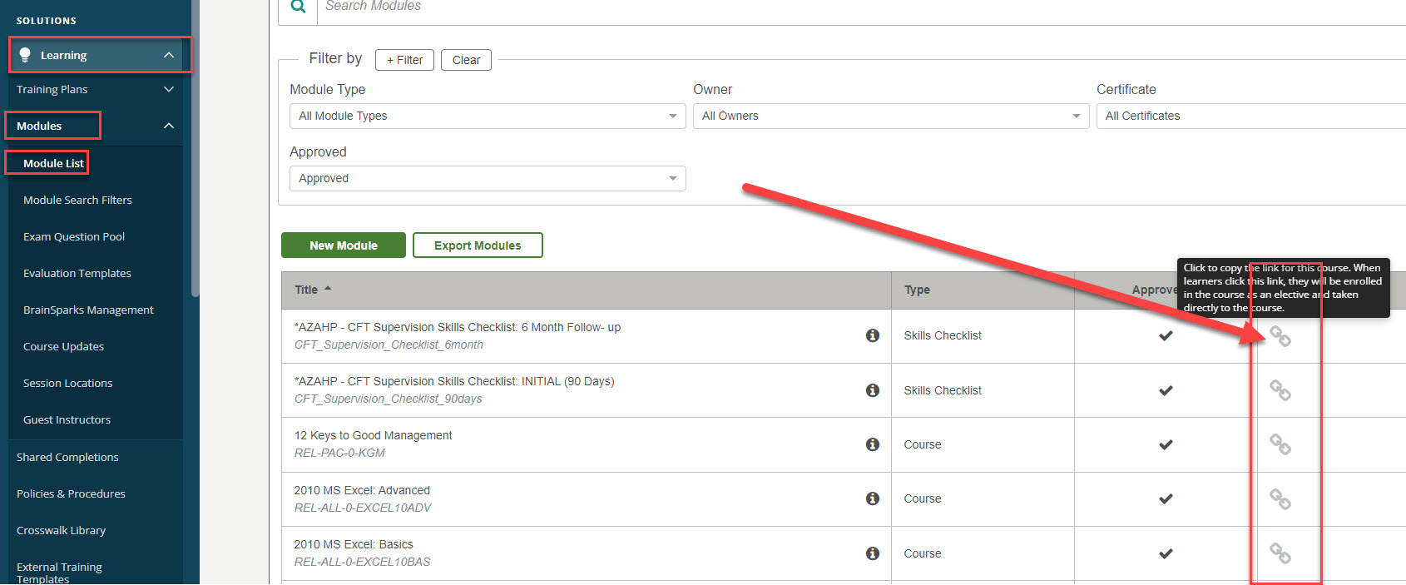
Relias Tips/Tricks
Did You Know – Relias has ClicktoLearn Links!
• Relias modules have ClicktoLearn links available in the module properties tab. You can also click on the icon shown in the referenced photo to copy the module's ClicktoLearn link.
• You can utilize these links to self-enroll and launch the course directly by selecting the link! These are unique to each Relias Platform so you would only want to utilize the link if and only if you have an active Relias profile in that Platform.
• Relias modules have ClicktoLearn links available in the module properties tab. You can also click on the icon shown in the referenced photo to copy the module's ClicktoLearn link.​
• If you have access to a QR code maker/generator, you can utilize the ClicktoLearn links to generate a QR code to self-enroll and launch a course after scanning the QR code!

Slide 13

Relias Administrative Mastery Program (RAMP)
RAMP is a training plan program for Relias Administrators that covers site and overview, user management, hierarchy, courses, training plans, and reporting in the Relias Platform that is available in your training plan list for Relias Administrators to self-enroll into!
Navigate to your Training Plan List from your Relias Administrator profile and search for "RAMP" if you would like to self-enroll.
The courses will take between 30-90 minutes and include knowledge checks throughout to aid with knowledge retention.
Become certified as a Relias Administrator upon completion!
Polling Time! Any progress?

Slide 14

Relias Office Hours
Have questions or new to your role? Relias CSM, Relias Connect, & Relias Support by your side!
Enterprise Client Success Manager
Joe Chemali
jchemali@relias.com
Relias Technical Support
1-800-381-2321
Hours of Operation: Mon – Fri (8 AM - 8 PM EST)
Relias Connect
AzAHP Learner Support
1-833-224-4008
Hours of Operation: Mon – Fri (8 AM - 8 PM EST)
Link to Resource: https://connect.relias.com/s/learner-page/aA13w000000k9xdCAA/paid-learner-support-page-for-arizona-association-of-health-plans-inc

Slide 15

AHCCCS Housing Program & ACOM 448
Erin La Palm
Housing Coordinator
United Healthcare Housing + Health Program
Erin_lapalm@uhc.com
Housing 101 Resources and Referral Guide - Erin L., United

Slide 16
AHCCCS Housing Program & ACOM 448
Safe, stable, secure housing is a basic need that impacts every aspect of physical and mental health. Although the federal Medicaid program does not pay for housing, the State of Arizona allocates limited funding to AHCCCS to provide housing subsidies to members with a Serious Mental Illness (SMI) designation, and a limited number of members with General Mental Health/Substance Use (GMH/SU) behavioral health needs. Providing supportive housing services not only helps members gain and maintain housing, it also helps lower utilization of emergency and crisis services. AHCCCS provides supportive housing services to approximately 3,000 members across the state.
AHCCCS Housing Program
The AHP is community-based permanent supportive housing where a member should have a renewable lease. Housing subsidies are provided for permanent supportive housing scattered site units, dedicated site-based units (Community Living Program). All subsidized rental units must meet or exceed all federal minimum Housing Quality Standards (HQS) of health and safety, as well as any additional State requirements, and have a reasonable rent based on market standards. Members are expected to pay up to 30% of their income toward their rent while the balance is subsidized by the program. This subsidy is paid to the landlord directly by the contracted AHP Housing Administrator on behalf of the member/household
Effective October 1, 2021, Arizona Behavioral Health Corporation and HOM, Inc., will become the new centralized Housing Administrator for the AHCCCS Housing Program (AHP) throughout the State of Arizona.
Arizona Behavioral Health Corporation - azabc.org/ahp/
AHCCCS Housing Program Application Guide
AHP Housing Application – Fillable PDF
AHP Eviction Prevention Application Packet
ACOM 448 – Housing Policy
ACOM 448 – Housing Policy was revised to align with the AHCCCS Housing Administrator RFP. Beginning October 1, 2021, ACOM 448 Housing policy applies to ACC, DD/EPD, LTC, RHBA contracted MCOs and their subcontracted provider network.
MCOs & Behavioral Health Providers are required to:
  Identify, assess, and screen members for housing needs
  Submit referrals & required eligibility documentation to ABC/HOM
  Participate and support eligible members through the AHP and other mainstream housing processes including finding housing and maintaining housing

Slide 17
Additional Trainings and Resources
Trainings
Corporation for Supportive Housing Training Center
HUD Resources: Webinars & Virtual Trainings
SAMHSA Permanent Supportive Housing Evidence-Based Practices Kit
SAMHSA Advisory: Behavioral Health Services for People Who Are Homeless
HUD Resources Locator - https://resources.hud.gov/#
Supportive Housing Competencies
Supportive Housing 101
Housing First in Practice
Homeless Systems and Coordinated Entry
Property Management Interaction Best Practices
Tenant/Landlord Risk Mitigation
Trauma-Informed Approaches to Supportive Housing
Harm Reduction Principles
Reasonable Accommodations for Tenants in Supportive Housing
Enhancing Tenant Quality of Life
Crisis Intervention & De-escalation
Navigating Service Coordination
Promoting Housing Stability through Active Engagement
Cultural Competency
Eviction Prevention Practices

Slide 18
Coordinated Entry
Any individual experiencing homelessness or in imminent risk of homelessness should be referred to the Coordinated Entry system in their community. Click the links below to access more info about services available in each region.
Homeless Services in Arizona: Continuum of Care & Coordinated Entry System (chameleoncloud.io)
This link takes you to a self-paced training on Coordinated Entry System and Continuum of Care
Tucson/Pima County CoC
  Tucson Pima Collaboration to End Homelessness (TPCH) is a coalition of community and faith-based organizations, government entities, businesses, and individuals committed to the mission of ending homelessness and addressing the issues related to homelessness in our community.
  Locate community access points here
Phoenix/Mesa/Maricopa County Regional CoC
  Staffed by the Maricopa Association of Governments since 1999, the Continuum of Care has successfully competed well in the national application for funding. Over the years, the HUD funding award has increased and now supports more than 40 homeless assistance programs in 13 different agencies.
  Locate community access points here
Arizona Balance of State CoC (Pinal and Gila County)
  The Arizona Department of Housing serves as the Collaborative Applicant and Homeless Management Information System (HMIS) lead agency for the Continuum of Care for the 13 non-metro counties in the state
  Search community access points by county here

Slide 19
Additional Housing Resources
Mainstream Housing Programs
Subsidized apartment search
Affordable-Housing-Search-Binder-6-2021.pdf (az.gov)
Public Housing Authorities (Section 8)
Section 202 Supportive Housing for the Elderly
Section 811 Supportive Housing for Persons with Disabilities
Sober Living Housing
AZ Recovery Housing Association Certified Sober Living Communities
Tenant Resources
Emergency Rental Assistance
HUD Approved Housing Counseling Agencies
HUD - subsidized apartment complex search link
https://resources.hud.gov/

Slide 20
Health Plan Housing Coordinators
United HealthCare | Erin La Palm | Erin_Lapalm@uhc.com
Arizona Complete Health | Patti Lopez | Palopez@azcompletehealth.com
Molina HealthCare | Cinda Thorne | Cinda.Thorne@molinahealthcare.com
Mercy Care | Jennifer Page | PageJ4@mercycareaz.org
Banner Health | Kayla McGhee | Kayla.McGhee@bannerhealth.com
Blue Cross Blue Shield | Eric Marcus | Eric.Marcus@azblue.com
Care1st | Kristi A Denk | Kristi.Denk@care1staz.com

Slide 21


Provider-
Workforce Development Plan
(P-WFDP)
Template

Slide 22
2024 P-WFDP Template
Template Release Date: October 12th, 2023
Competency Continuum Release (scoring rubric): December 2023
Extension/Exemption Request Deadline: January 15th, 2024
Due Date: February 1st – February 29th, 2024
“The future of organizations is the growth of the people in them.” - Unknown
New This Year: Agencies that participated in the 2022 AHCCCS DAP and/or received “EXEMPLARY” status on their 2023 P-WFDP submission may elect to submit a shortened form (V2) of the 2024 Provider-Workforce Development Plan (P-WFDP) that focuses on WFD goals. As an option Providers may choose to submit the full form (V1), instead, if they would like to update their WFD initiatives in all areas (including WFD goals, succession planning, culture and employee competency).
Version 1 (V1)
vs.
Version 2 (V2)
P-WFDP Resources: Click Here

Slide 23
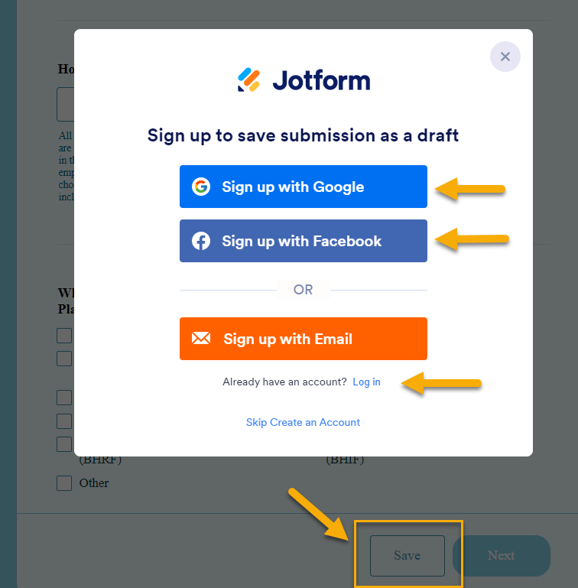
2024 P-WFDP (Jotform) Template
Instructions:
P-WFDP Resources
Click “Version 1” or Version 2”
Enter your agency name at the top of the form
Scroll to the bottom of the template and select “Save”
Create an account or Login to your existing account
Save the “Sharable” Link that is generated
  If you do not save this link the WFD Alliance cannot recover information you have entered on the form.
You can share this link with trusted team members that will be helping you develop your P-WFDP
“The future of organizations is the growth of the people in them.” - Unknown

Slide 24
2024 P-WFDP Workshops
Course Name: *AzAHP - Provider Workforce Development Plan (P-WFDP) Workshop
Register: Relias (search “workshop”) in your Module List
  NOTE: You can only register for 1 session at a time
      02/14/24 3:00 – 4:30pm (Wednesday) ❤
Agenda:
1st Hour: Review the entire P-WFDP Template in a large group
Break-Out Sessions: To review individual agency questions with a member of the WFD Alliance
“The future of organizations is the growth of the people in them.” - Unknown
Additional Supports:
1:1 Consultation by request: The WFD Administrators are available for consultation via email, phone, or webinar. Please contact us as needed to schedule a meeting.
Competency Continuum: This is the tool that the WFD Alliance utilizes to provide each agency with feedback for their P-WFDP submission. A blank copy of this form will be posted to the AZAHP website by December to help guide and prepare your agency for submission of the plan. P-WFDP Templates Resources: Click Here

Slide 25


Bachelor of Science (BS) in Behavioral Sciences
https://www.southmountaincc.edu/events/bachelors-degree-behavioral-sciences-information-sessions
April 19, 2022

Slide 26







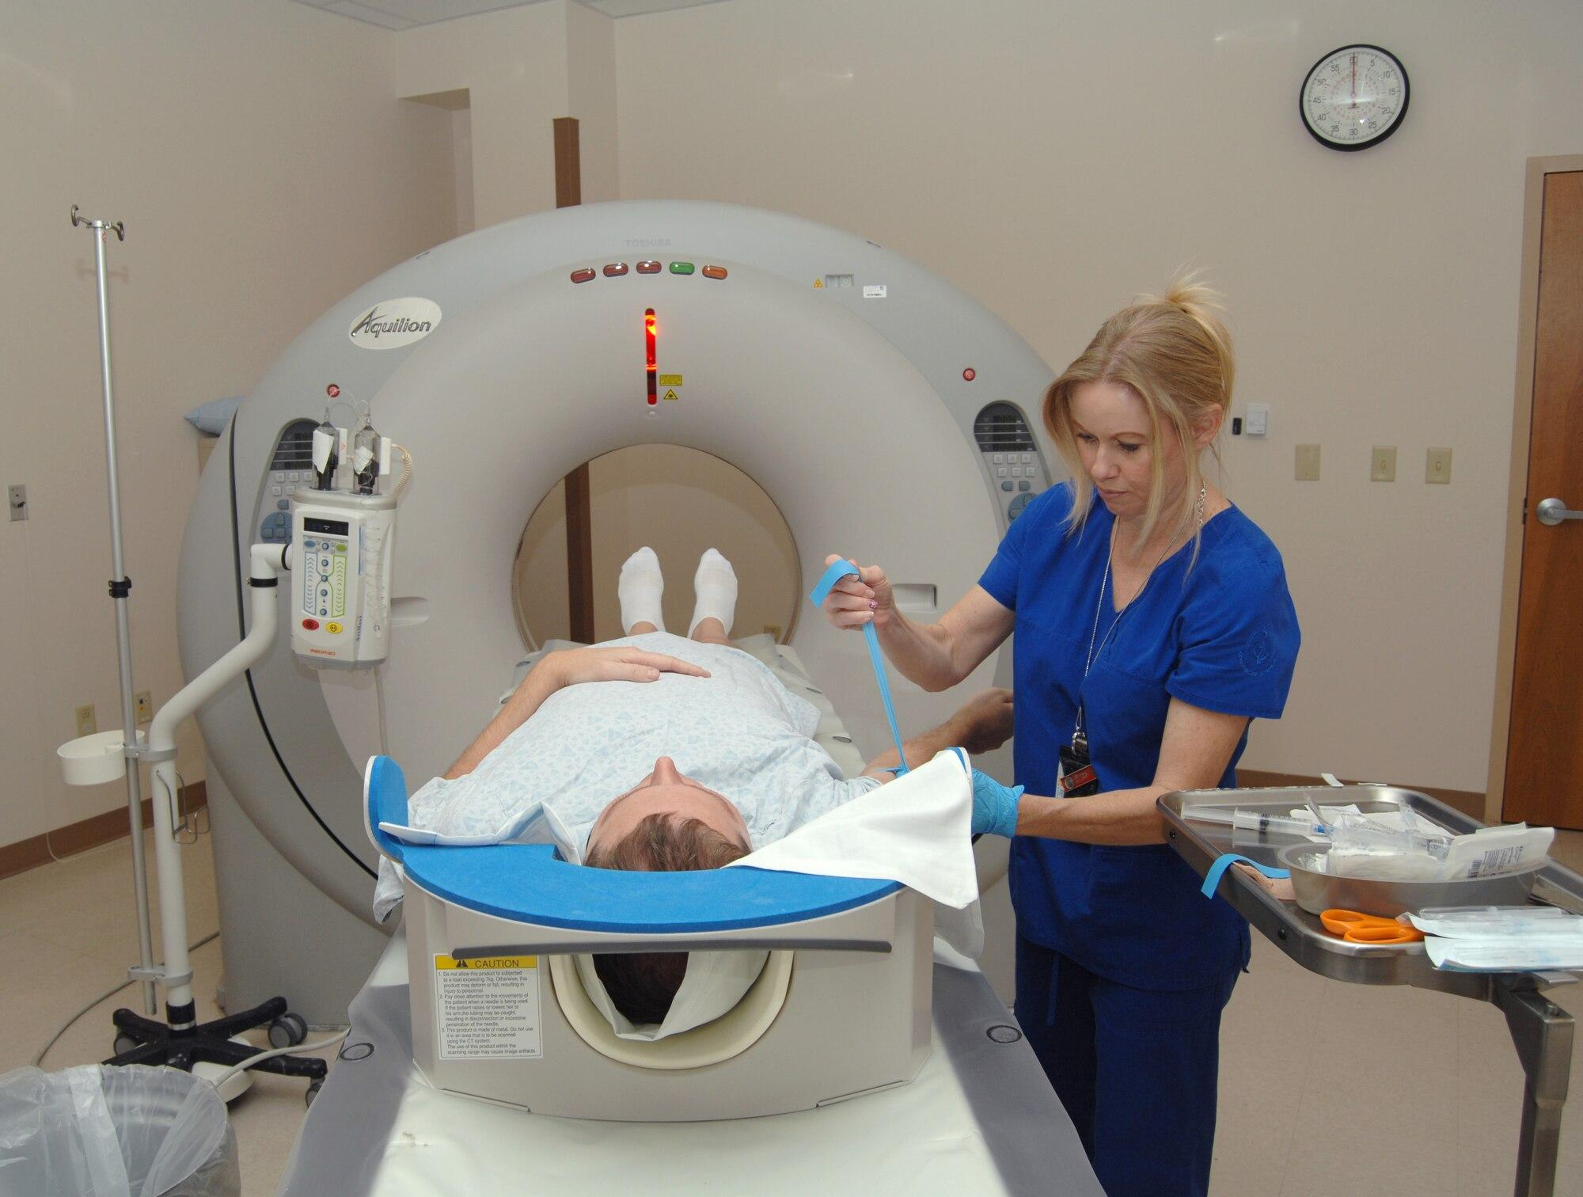
Spring 2024
MCCCD Bachelor’s Degree Programs
EARLY CHILDHOOD -
DUAL LANGUAGE
ELEMENTARY AND
SPECIAL EDUCATION
DATA ANALYTICS
& PROGRAMMING
INFORMATION TECHNOLOGY
MESA
GLENDALE, PARADISE VALLEY, RIO SALADO
MESA
PHOENIX
PUBLIC SAFETY ADMINISTRATION
BEHAVIORAL SCIENCES
NUCLEAR MEDICINE
PHOENIX, RIO SALADO
SOUTH MOUNTAIN
GATEWAY

Slide 27



Advantages of getting a bachelor’s degree at Maricopa Community College
1.
2.
3.
Affordable
Personalized Support
Flexible Modality
Complete a bachelor’s degree for a fraction of the cost at a local 4-yr university
Small class sizes and personalized support from your faculty and staff
In person and online options are available

Slide 28

Average Cost of Attendance (120 credits)
Bachelor’s Degree Programs
A quality 4-year education at a fraction of the cost
County Resident Base Tuition - Lower Division (100/200) | $97.00 per credit hour
County Resident Base Tuition - Upper Division (300/400) | $145.50 per credit hour
Estimated Tuition Range for 120 Credits 30-55 upper division credits | $6,305 - $8,730 100/200 $4,365 - $8,002 300/400
Fees | $320
Books & Supplies | $6,000
County Resident 4-Year Total Average Cost for 120 Credits | $19,415 - $20,627
Out-of-State Total Average Cost ($275 surcharge per credit) | $46,095 - $51,512

Slide 29
Paying for College
Bachelor’s Degree Programs
Title IV Financial Aid Eligibility is approved for South Mountain Community College; financial aid levels will be adjusted for junior/senior standing within your program of study
We recommend that you complete the 2023-2024 Free Application for Federal Student Aid (FAFSA)
  SMCC’s Title IV Code: 015001
Veteran Benefits approved with the State Approving Agency

Slide 30
Ways to Pay
Bachelor’s Degree Programs
Secure your classes by making a plan to pay your tuition by the due date using one or more of the following options:
Federal Financial Aid
Scholarships - Maricopa Foundation Scholarships are available mcccdf.org/scholarships
Behavioral Health Scholarship - AHCCCS
Self-pay (Payment Plan availability)
Third-party authorization
Veteran’s Benefits

Slide 31
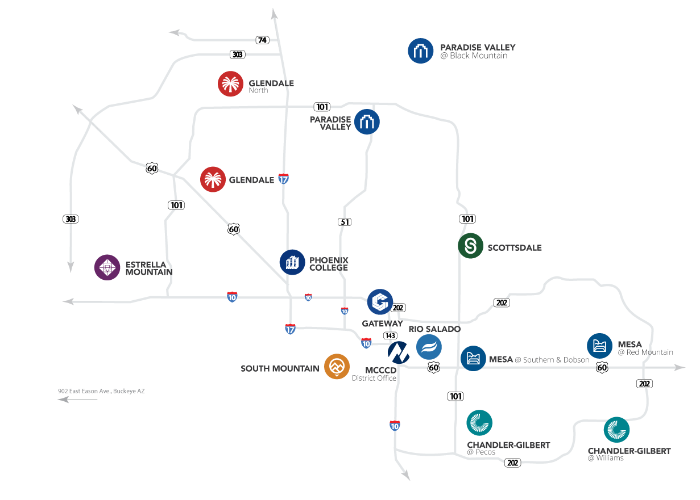
Convenient Locations
Bachelor’s Degree Programs
Students can take up to 90 credits of required lower division coursework across the Maricopa Community Colleges

Slide 32
How will this degree help students
and our community?
According to the nonprofit group Mental Health America, Arizona ranks 47th among all 50 states and the District of Columbia in the rate of available mental health care providers.
The state’s ratio of 790 people for every one provider is alarming when contrasted with Massachusetts' leading rate of 180 to 1.
Furthermore, Arizona ranks last of all states in the percentage of children ages 0 to 17 (30%) with at least two Adverse Childhood Experiences (ACES), which is the leading indicator of both present and future mental health care needs (Reinert et al., 2019).

Slide 33

Job/About
Behavioral Sciences
The Bachelor of Science (BS) in Behavioral Sciences provides students with an advanced study of human behavior and the skills necessary to develop and implement specialized and comprehensive behavioral health and social services to individuals and families dealing with mental illness, substance use disorders and addiction, trauma, developmental disabilities, comorbid medical conditions, and challenging behaviors.

Slide 34
Job/About
Behavioral Sciences
If you’re interested in working:
In a hospital setting
a school
a clinic
If you’re interested in working with:
individuals with serious mental illness
children
adolescents
families
individuals experiencing addiction
individuals with developmental disabilities
individuals with autism

Slide 35
Coursework/Requirements
Behavioral Sciences
Micro-certifications - courses are designed to meet the qualifications for industry certifications in the field of mental health.
Multiple degrees (AA+AAS) & district certificates (AGEC+CCL’s)
Core courses in professional resilience/well-being, ethics, trauma-informed care and recovery, applied behavior analysis, therapeutic communication skills, individual therapy, group therapy, etc.
Elective courses in crisis and trauma stabilization, emergency mental health crisis response and recovery, infant and early childhood mental health, integrated behavioral treatments, etc.
Internships (x2) (BHS 190 + BHS 490): Includes field-based clinical experiences, professional portfolio development, and a capstone project. Opportunities for paid internships.

Slide 36
Industry Certifications
Behavioral Sciences
Certified Trauma Support Specialist (CTSS) through the Arizona Trauma Institute and International Trauma Institute
Applied Suicide Intervention Skills Training (ASIST) through LivingWorks
Certified Trauma Recovery Specialist (c-TRS) through the National Institute of Behavioral Medicine
Certified Resilience Professional (CRP) through the Arizona Trauma Institute and International Trauma Institute
Certified Mindfulness-Informed Technician (c-MIT) through the National Institute of Behavioral Medicine
Psychological First Aid (PFA) through the National Child Traumatic Stress Network
Certified Professional Resilience Technician (c-PRT) through the National Institute of Behavioral Medicine)
Mental Health First Aid (MHFA) through the National Council for Mental Wellbeing
Nonviolent Crisis Intervention (NVCI) through the Crisis Prevention Institute
Certified Self-Care Technician (c-SCT) through the National Institute of Behavioral Medicine
Registered Behavior Technician (RBT) through the Behavior Analyst Certification Board
Certified Mental Health Technician (c-MHT) through the National Institute of Behavioral Medicine
Certified Mental Health Wellness Coach (c-MHWC) through the National Institute of Behavioral Medicine

Slide 37
Admissions Requirements
Bachelor’s Degree Programs
Apply online at admissions.maricopa.edu
  South Mountain Community College
  Spring 2024 semester
  Select the Bachelor of Science (BS) in Behavioral Sciences degree (Plan Code 9300)
Submit all official transcripts outside of the Maricopa County Community College District for transfer evaluation to the SMCC Admissions and Records office ASAP.
  ATT: Admissions, 7050 S. 24th Street, Phoenix AZ 85042

Slide 38
Admissions/Credits/Schedule
Behavioral Sciences
No additional admission requirements
120 credits
Schedule/Class Format - Classes are offered in-person, online, hybrid and live online
The bachelor’s degree program is designed to meet the state qualifications for a Licensed Substance Abuse Technician.
The degree also allows students to apply for graduate programs to obtain higher levels of licensing such as
  Licensed Professional Counselors (LPC)
  Licensed marriage and family therapists (LMFTs)
  Licensed Master Social Worker (LMSW)
  Licensed Independent Substance Abuse Counselor (LISAC)
  Licenced Behavior Analyst (LBA)
  Licensed Clinical Psychologist (LP)

Slide 39
Transfer Credit
Bachelor’s Degree Programs
Arizona General Education Curriculum (AGEC) required - changes anticipated Fall 2024
At least 30 credit hours of required lower or upper division courses must be completed at South Mountain Community College
  Note: Completing an Associate’s degree prior to starting the bachelor’s degree is not required.
  This is not a 2 + 2 program: Students entering with prior Associate’s degree completion will be required to complete required coursework
  Students who have completed lower division coursework in BHS are positioned to begin upper level coursework, provided prerequisites are met

Slide 40


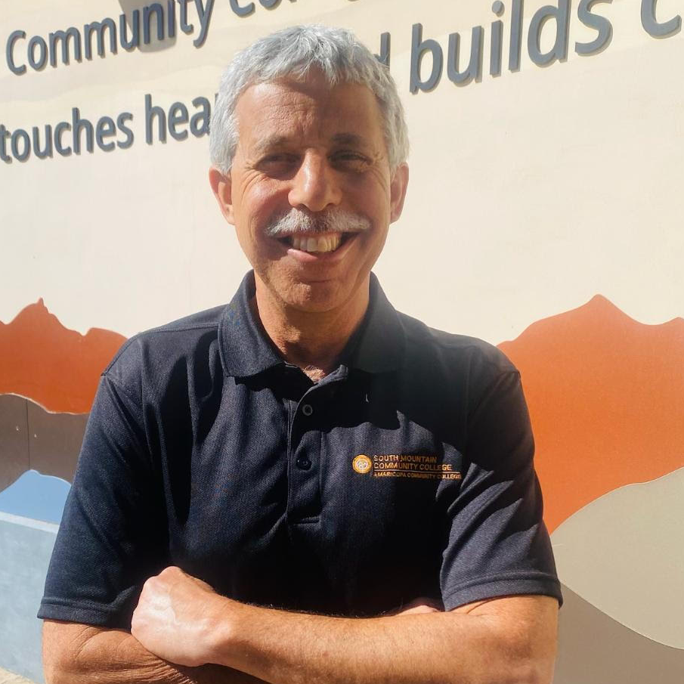
Contacts
Behavioral Sciences
Dr. Thomas Edward Rojo Aubrey, Program Director - English/Spanish (Español)/Basic Korean - Email: thomas.aubrey@southmountaincc.edu
Joshua Schwalbach and Mark Sanders
Academic Advisors
behavioralsciences@southmountaincc.edu
southmountaincc.edu/aaa (appointments)

Slide 41


Thank you!
Questions?
Roberto Valenzuela
Workforce and Recruitment Manager
roberto.valenzuela@southmountaincc.edu
Manny Hernandez -
Career Services Manager/Internship Coordinator
manuel.hernandez@southmountaincc.edu

Slide 42




Update
Child and Adolescent Level of Care Utilization System (CALOCUS)
AHCCCS providers who deliver behavioral health services to children and adolescents are required to conduct the CALOCUS. While not currently required, any other trained provider (PCP, pediatrician, or physical health provider, etc.) who works with children and adolescents is also able to conduct the CALOCUS assessment and can coordinate with other treating providers to share the assessment results for care coordination purposes. Providers are required to have evidence within the clinical chart for members between the ages of 6 and 18, that a CALOCUS was completed as outlined in AMPM 320-O. Providers can include a CALOCUS provided by a referring agency in a member’s clinical chart to meet this requirement. All providers are required to have trained staff and the ability to complete CALOCUS, in the event that a clinical need arises.
        To schedule training: Providers will use https://www.deerfieldsolutions.com/
        To create an account and complete assessments: Providers should still go to https://locus.azahcccs.gov/
        AHCCCS FAQ- CALOCUS

Slide 43

Child and Family Team (CFT) Updates
Please Ensure you complying with the required CFT Competency Evaluation Tool in Relias for CFT Facilitators
  (Updated) *AzAHP - CFT Supervision Tool (Facilitator Competency Evaluation - 90 Day)
  ​(Updated) *AzAHP - CFT Supervision Tool (Facilitator Competency Evaluation – 6 Month)
  (Updated) *AzAHP - CFT Supervision Tool (Facilitator Competency Evaluation - Annual)
Triannual CFT Champion Meeting is February 29th from 9am – 11am, sign up in Relias
We are in week two of updates to the 2 Day CFT Curriculum
  This update is a collaboration between HP’s, provider organizations, CSOC’s, OIFA, and AHCCCS
  The updated training materials will be reviewed with CFT Champions at the June Triannual Meeting
  The outdated material will be retired July 1, 2024.

Slide 44

Division of Developmental Disabilities
Training Initiatives for Behavioral Health Providers
RELIAS TRAINING PLAN AND INCENTIVE
Intellectual and Developmental Disability (I/DD) Course Library - available on Relias and includes more than 100 I/DD-related courses, many that are CEU-eligible.
DDD - Intellectual & Developmental Disabilities Essential Knowledge for BH Providers Training Plan
Incentive funding is available to eligible behavioral health provider agencies that have a minimum of 10% of their clinical staff (BHMP, BHP, BHT, BHPP) complete the training plan.
12 computer-based courses and 1 virtual instructor-led course which includes introduction to DDD and information helpful for coordination of services
For details, see:
https://des.az.gov/services/disabilities/developmental-disabilities/vendors-providers/dual-diagnosis-training
THE DEADLINE FOR COMPLETION OF TRAINING HAS BEEN EXTENDED TO 6/30/2024!

Slide 45

Training Plan Course Completions
Training Plan: DDD - Intellectual & Developmental Disabilities
Essential Knowledge for BH Providers
Course Completions 8/1/2023 – 1/31/2024
47 Behavioral Health Provider Agencies have enrolled one or more staff members in the training plan
2,029 Individuals have completed one or more of the courses in the training plan
13,115 Courses in the training plan have been completed
979 Individuals have completed the virtual instructor-led course.
If you would like to receive a report detailing your organization’s progress in completing the training plan, or if you have any questions about this initiative, contact DDD at: dddbhtraining@azdes.gov.
THERE IS STILL TIME TO JOIN THIS INITIATIVE
THE DEADLINE FOR COMPLETION OF TRAINING IS 6/30/2024

Slide 46

Save the Date
DDD Conference for Behavioral Health Providers
Bridging the Gap for Individuals with Developmental Disabilities and Behavioral Health Needs
May 9 - 10, 2024 – Casino Del Sol, Tucson & September 5 – 7, 2024 - Desert Willow Conference Center, Phoenix
Target Audience: Behavioral Health Provider Agency supervisors, counselors, case managers, peer and family support specialists, behavior coaches & others who may provide services for DDD members. The Phoenix conference will have additional tracks for Behavioral Health Medical Professionals and Behavior Analysts.
Presentations and workshops by locally and nationally recognized experts
Continuing education credits will be available to attendees.
No cost to attend, but registration is limited to the first 250 who enroll.
If you offer any specialized programs for individuals with developmental disabilities and would like to have a vendor table at the conference, contact our team at: dddbhtraining@azdes.gov.
Watch for future announcements and registration information

Slide 47

DD Spotlight
According to the Center for Disease Control, Autism Spectrum Disorder (ASD) is a developmental disability that affects an estimated 1 in 44 children in the United States. ASD is characterized by significant issues with social skills, communication, and repetitive behaviors. Since it is a spectrum disorder, the degree to which a person’s functioning is impacted varies greatly from one individual to the next. AHCCCS: Resources for Members with ASD
ASD Screening:
Autism Spectrum Disorder is 1 in 36 individuals nationwide per CDC 2023.
On average, the state of Arizona is diagnosing around 4.5 years of age.
Early screening and identification of ASD is important as it can be diagnosed as early as 18 months.
AHCCCS has approved 3 screening tools that PCP’s, BH providers, etc. can use to support younger children – M-CHAT, PEDS, and ASQ-SE. Each health plan has resources to support with training in the event providers are seeking more information.
Here are some links providers can explore themselves. Please note, these are not assessment tools but support with early identification.
  PEDS: https://www.pedstest.com/
  ASQ SE: https://agesandstages.com/products-pricing/asq3/
  M CHAT: https://mchatscreen.com/
ASD Diagnosis:
Division of Developmental Disabilities (DDD) eligibility: ASD is a qualifying DDD diagnosis. Determinations for DDD coverage are at 4 and 17. Will need the following individuals to diagnosis ASD for members to qualify – Developmental Pediatrician, Psychologist, Psychiatrist, Neurologist or Pediatrician who has completed specialized training. ** Please stress the importance of others diagnosing ASD, everyone believes only a Developmental Ped can and waitlists are 2+ years. We have others that can do it as well as the health plan resources.

Slide 48

Nia Uhlenhake, CFSP
Family Support Services Supervisor
Notes:
Thank you for this opportunity to…………
When we were first invited to be here, then told there would be availability in April, I thought, well, that’s perfect since April is World Autism Month.

Slide 49
Arizona Autism United (AZA United)
is a local nonprofit organization that has provided therapies and services to individuals living with autism and their families since 2006.
Mission
is to help as many families as possible with individualized supports.
Vision
is to become a model autism organization that provides comprehensive services across the lifespan, with facilities throughout the state of Arizona.

Slide 50

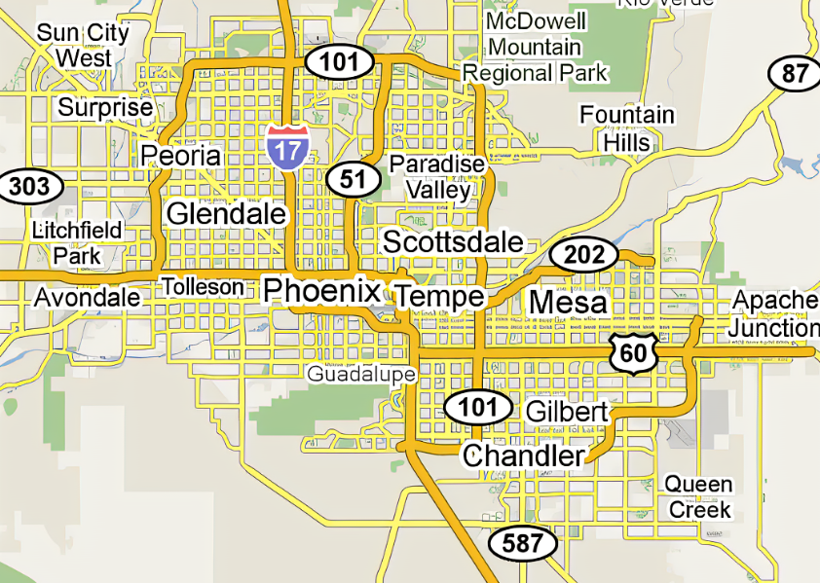
Locations
Coming Soon
AZA North
Valley Center
AZA
headquarters
AZA West
Valley Center
AZA East
Valley Center
Chandler
office
Notes:
AZA United headquarters is located in Phoenix, on Washington and 50th St. Our Counseling and Diagnostics Clinics are located at our main office, as well as a Speech Therapy Team.
Our East Valley Center, located in Mesa, opened in March of 2020. In spite of that, it has now become the model for other centers.
Our West Valley Center is located in Avondale. We offer ABA, Speech and Occupation Therapies, Counseling, Diagnostics.
Our Chandler office, the Southeast Valley Center, offers another Speech and Occupational Therapy team, and soon, another Diagnostics clinic.
We feel so strongly about growing with a purpose. We have so many families that depend on us for their daily needs so we must be responsible with expansions.

Slide 51
What is Autism?
Autism Spectrum Disorder is a developmental disability that can cause significant social, communication, and behavioral challenges.*
Less Autistic
More Autistic
*CDC Definition
Notes:
What is Autism? READ…
Often, when people think of a spectrum, they imagine something linear and we hear a lot of
“high functioning” and “low functioning” so we can’t help but think that some people are “less autistic” while others are “more autistic.” This isn’t at all the case though. Autism is not linear. In fact, it looks more like this…

Slide 52

What is Autism?
Autism is a developmental disability that can cause significant social, communication, and behavioral challenges.*
depression
fixations
aggression
abnormal/flat speech
tics & fidgets
noise sensitivity
poor eye contact
social difficulty
abnormal posture
anxiety
*CDC Definition
Notes:
Autism can have so many symptoms, including those listed here.
Autism doesn’t mean someone has a low IQ either.
In fact, many autistic individuals test highly gifted, yet they struggle with other symptoms.
Maybe they’re sensitive to noise, or can’t make eye contact, and have social anxiety.

Slide 53

What is Autism?
Autism is a developmental disability that can cause significant social, communication, and behavioral challenges.*
Person A Person B
*CDC Definition
Notes:
No two autistic people are exactly alike. Looking at these wheels, we can see that both people who have autism, have different symptoms and at different intensity.

Slide 54

Autism affects
1 in 36 children in the U.S.
Notes:
In the most recent publications, it has been noted that 1 in 36 children in the US have Autism.

Slide 55
WHAT WE DO: PROGRAMS & SERVICES
CHILDREN/ADULTS
Diagnostic Evaluations
Speech & Language Therapy
Occupational Therapy
Feeding Therapy
ABA Therapy
Clinical Family Coaching
Habilitation
Attendant Care
Social Skills Groups
Notes:
AZA United is here to support individuals with autism, their families, and their community by providing Support from the Start and through their Journey.
We offer Diagnostic Evaluations, Speech, Language, and Feeding Therapy, Occupational Therapy, ABA Therapy, Clinical Family Coaching, which is a Behavior Coaching program for challenging behaviors, Individual counseling, Habilitation, Attendant Care, and Social Skills Groups.

Slide 56
WHAT WE DO: PROGRAMS & SERVICES
FAMILIES
Parent Training & Advocacy
Support Groups for Parents
Respite Care
Programs for Siblings
Family Counseling
Family Support
Parent Provider Program
Notes:
For Family members, we offer Parent Training and Advocacy, Support Groups, Respite Care, Programs for Siblings, Family Counseling and generally Family Support.

Slide 57
WHAT WE DO: PROGRAMS & SERVICES
COMMUNITY
School Consultation
Autism Awareness/Acceptance Training
Ride-A-Bike Program
Notes:
Within the Community, our team is available for School Consultations, Autism Awareness and Acceptance Training, and our Ride-A-Bike program, where families are able to borrow a balance bike so their loved one can learn how to balance and eventually learn how to ride a bike.

Slide 58
WHAT WE DO: TRAINING
TRAINING OPPORTUNITIES
Article 9
CPR & First Aid
Prevention & Support
Positive Behavior Support
Direct Care Worker Training

Slide 59
Family Support Services
What is Family Support?
Navigating systems of care
Relevant & accurate information
Coaching
Community Resources
Services within or outside of AZA United
Notes:
I’d like to take some time to talk about Family Support Services. What is Family Support? Our family support team helps families understand and navigate the systems of care for individuals with autism and other developmental disabilities. We work to ensure that information we provide is relevant and accurate. We provide coaching to families and give them the skill to feel empowered to be their own advocate. We also ensure to families are lead to appropriate community resources. We do all this through phone consultations, in-person appointments, group events, and trainings. We help families no matter their stage of the autism journey.

Slide 60
Family Support Services
Who Receives Family Support?
Parents/Guardians
Family members
Individuals with autism
Community members
Notes:
Family support services is available to any parent or guardian, family members, individuals with autism, and community members.. We’re available to help any family in need of support. Families do NOT need to be clients receiving services with AZA United. This is absolutely free to families and individuals. Families also do not need to live in Arizona to get family support services. We’re happy to help families anywhere in the world.

Slide 61
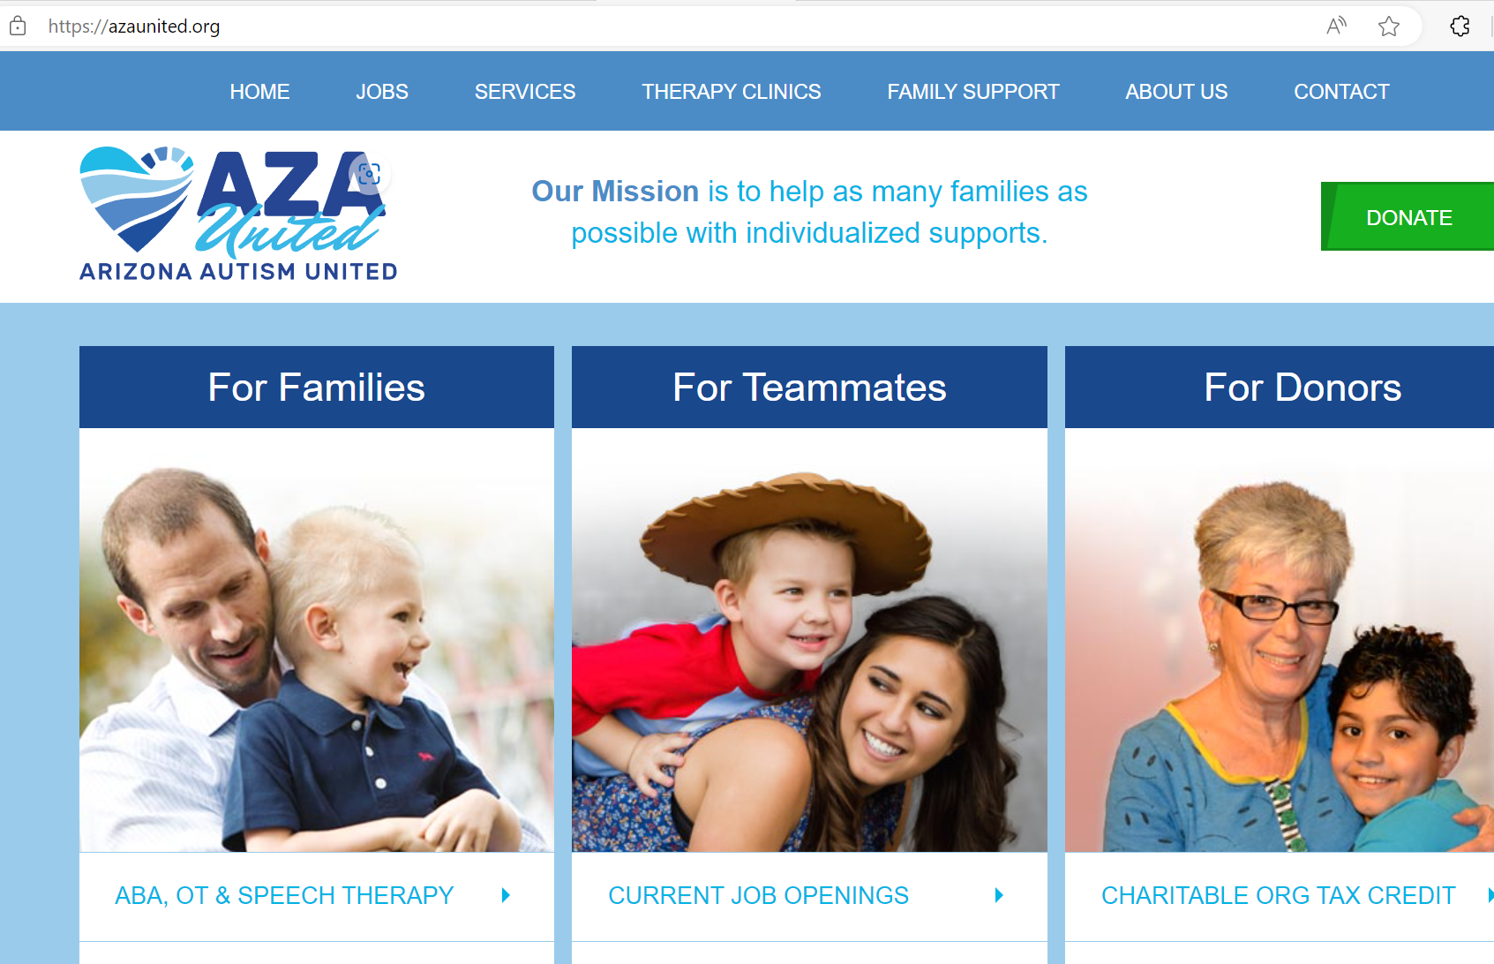
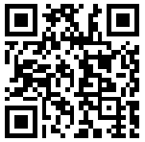
Family Support Services
Getting Started
Book an appointment
www.AZAunited.org

Slide 62
Thank you! www.AZAunited.org

Slide 63
Questions?

Slide 64

BRAIN BITES
Employee Rewards & Recognition Initiatives
Pamela Wooden - Horizon Health & Wellness

Slide 65

Employee Rewards & Recognition Initiatives
Best Practices
Employee Appreciation Committee
Teaching and Mentoring Opportunities for those who exceeded their competency goals
All staff (full-time, part-time, LBE 32 or LBE 36) received a “bonus” in the form of a fuel stipend once per month
Notes:
HHW is a fee for service facility. We never turn anyone away for not being able to pay.
We are monitored by several agencies and health plans. Those are:
Arizona Department of Health Services (ADHS)
Arizona Health Care Cost Containment Services (AHCCCS)
Department of Developmental Disabilities (DDD)
Joint Commission
Health Resources Service Administration (HRSA)
Arizona Association of Health Plans (AzAHP)

Slide 66
Employee Rewards & Recognition Initiatives
Best Practices
Birthday Benefit
On the Rise – Internal Communication Platform
Notes:
HHW is a fee for service facility. We never turn anyone away for not being able to pay.
We are monitored by several agencies and health plans. Those are:
Arizona Department of Health Services (ADHS)
Arizona Health Care Cost Containment Services (AHCCCS)
Department of Developmental Disabilities (DDD)
Joint Commission
Health Resources Service Administration (HRSA)
Arizona Association of Health Plans (AzAHP)

Slide 67
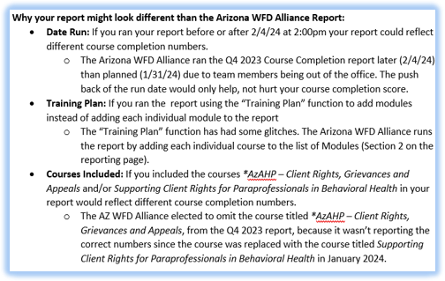

2023 Q4
Course Completion Report
Q3 2023 Results
90.39% across all agencies
⭐100%: 127 (31%)
🏅90-99%: 107 (26%)
80-89%: 44 (11%)
70-79%: 30 (7%)
60-69%: 20 (5%)
50-59%: 15 (4%)
Below 50%: 66 (16%)
409 Provider Agencies
Results are available at www.azahp.org
57% Meeting/Exceeding Expectations
<AZ Workforce Development Alliance – ACC, ACC-RBHA​
< Provider Resources​
< Quarterly Completion Reports (bottom of page)​
< Access Quarterly Completion Archives​
< Quarter 3, 2023
43% Below Expectations
Notes:
2023 Q3 Course Completion Report Results are available at www.azahp.org
<AZ Workforce Development Alliance – ACC, ACC-RBHA
< Provider Resources
< Quarterly Completion Reports (bottom of page)
< Access Quarterly Completion Archives
< Quarter 3, 2023

Slide 68


Best Practices in Workforce Development
AHCCCS— Professional Development initiative is a unique opportunity with focus on competency-building for workforce development and training staff.
AHCCCS has partnered with the Association for Talent Development (ATD) to provide expert-led professional development programs at no cost to eligible Arizona Medicaid providers who deliver Home and Community Based Services (HCBS) to enrolled AHCCCS (Medicaid) members.
ATD Training and Facilitation Certificate Program. This virtual, live instructor-led program is one of ATD’s most popular train-the-trainer offerings and helps new and seasoned trainers become learner-centric facilitators who apply the skills of an engaging and effective trainer.
ATD Integrated Talent Management Certificate Program. In this virtual, live instructor-led talent management program, participants will uncover the practices essential to achieving a successful integrated talent management approach for their organization. This program is intended for workforce development professionals, HR professionals, or leaders actively involved in workforce development activities.

Slide 69
Best Practices in Workforce Development
Although AHCCCS is offering ATD's professional development courses at no cost to eligible HCBS providers, there is a cost to AHCCCS.
These courses are valued at $1000 and are being paid for by AHCCCS through ARP (American Rescue Plan) federal funding. Therefore, by registering for this course, registrants are getting a reserved, paid seat.
Canceling or transferring a reserved/paid seat to another session must be submitted to customercare@td.org prior to/by the 4th business day before the start of the program.
There is a limit of one registered paid seat per participant per program.
Before completing the registration process, participants should consult with their supervisor and confirm commitment to be able to attend all scheduled days.

Slide 70

Best Practices in Workforce Development
We invite you to join upcoming Lunch & Learns, to learn more about these programs and to answer any questions you have.
30-minute sessions with time for Q&A
Attend one or both
February 14, 2024
Training & Facilitation Lunch & Learn 11AM: http://atdeducation.adobeconnect.com/r8o5e2rk1pl6/
Integrated Talent Management Lunch & Learn 12PM: http://atdeducation.adobeconnect.com/itmllahcccs/

Slide 71
Legacy Agency Spotlight
Legacy Agency Spotlight: An opportunity to recognize your agency or others for outstanding achievements related to workforce development made within the last 6 months.
Honorable Mention:
Beacon Group
Devereux Advanced Behavioral Health
H.O.P.E.S.S
Lateef Behavioral
Southwest Behavioral & Health
Transitional Living Center Recovery
2nd Runner Up:
United Cerebral Palsy of Southern Arizona
1st Runner Up:
Community Bridges

Slide 72

Legacy Agency Spotlight
Winner: COPE Community Services, Inc
Click Here For Results
Notes:
https://azahp.org/wp-content/uploads/2024/02/All-Agencies-Legacy-Agency-Spotlight-Certificate-Feb-2024-AzAHP-Website-Document.pdf

Slide 73

Creating Pathways to Better Health

Slide 74
Our Commitment to Workforce Development
• Monthly Jumpstart Newsletter: Kind Colleagues
Employee Assistance Program, Financial Wellbeing, Retirement Planning
• Prioritization of Wellness Activities & Employee Appreciation Events
• Professional Development Days, Restructuring Leadership Positions, Mentoring Opportunities
• Building Resiliency Skills Workshop, Seeking Safety Training, Diversity Equity & Inclusion Committee
• Transparency in Business Operations

Slide 75
Examples of Actions Taken
- Restructuring leadership to promote a coaching model
- Appreciation events
- DEI committee/events
- Transparency in business operations

Slide 76
Results
- Coaching leads to supportive environment
- Increase organizational morale with appreciation events
- DEI committee educates, strengthens, and promotes diversity in the workforce
- Transparency in business operations shows the “why” behind it all

Slide 77
Training Opportunities
29 Feb. 9AM – 12:30PM
Culture, Care and You Training
4 Apr. and 5 Apr.
Workforce Development Summit
Arizona Complete Health Care First
AzAHP Workforce Development Alliance
Questions? AzCHTrainingDepartment@azcompletehealth.com
Questions? Workforce@azahp.org

Slide 78




Valor in the Workplace: Empowering Veteran Talent
Join us for an exclusive webinar where we delve into the best practices for hiring, training, and retaining our nation's heroes and their advocates. Learn how you can enhance your organization's workforce with the unique skills and perspectives that veterans bring to the table.
Expert Panelists:
Ian Wilson, Veteran Advocate, UHC
Bill Manson, Vocational Rehabilitation Administrator, UHC
Josh Johnson, Director of Programs, Special Operators Transition Foundation (SOTF)
Angie Arias, Operations Coordinator, SOTF
Target Audience:
HR Professionals, Training & Compliance Officers, Marketing Teams, Talent Acquisition Specialists, and Transitioning Veterans & Their Supporters
Event Details
Date: April 23rd
Time: 10am-11am

Slide 79

R & R - Reminders and Resources
No Training of the Month for Relias
DREAM Pre-Employment and Dream Job Fair- Next Slide

Slide 80



Slide 81


We are switching to Teams!
Effective Next Meeting:
  March 14th, 2024
Same Time: 2nd Thursday of the Month from 11am-12:30pm MST
**Be sure to create a new reoccurring invite on your calendar with the link below!
Link:
    https://teams.microsoft.com/l/meetup-join/19:meeting_ZDBjMTU5MTAtMzJkNC00MDliLTljNDgtOTVmOGVmZWRhZmEx@thread.v2/0?context=%7B%22Tid%22:%224e6b076a-1c16-42e3-a8ea-752686e1424d%22,%22Oid%22:%224031f37a-6f0b-4ca9-97b7-6ccf06c7b467%22%7D

Slide 82


Open Discussion:
Questions, Suggestions, Ideas & Feedback

Slide 83

Thank You!

